Slide 1


Grasping follows Weber’s Law
Kriti Bhatia*, Christian Löwenkamp* & Volker H. Franz
University of Tübingen, Germany
*equal contribution
This work was funded by the Deutsche Forschungsgemeinschaft (DFG – German Research Foundation) – Project number 422180965; 381713393, within the Research Unit FOR2718: Modal and Amodal Cognition.

Slide 2

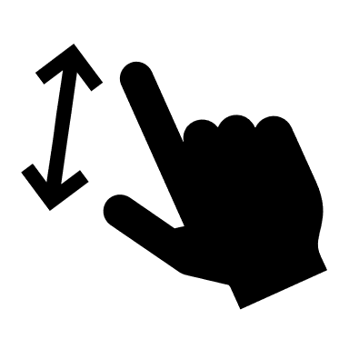
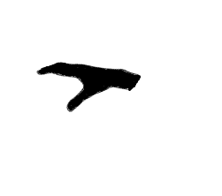
Perception-Action Model (PAM)
Goodale & Milner (1992)
Visuomotor Actions
Visuomotor Actions
Dorsal
Dorsal
V1
V1
Ventral
Ventral
Visually-Guided Grasping
Manual Size Estimation
Visual Perception
Visual Perception

Slide 3
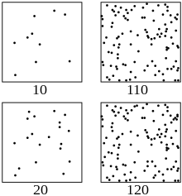
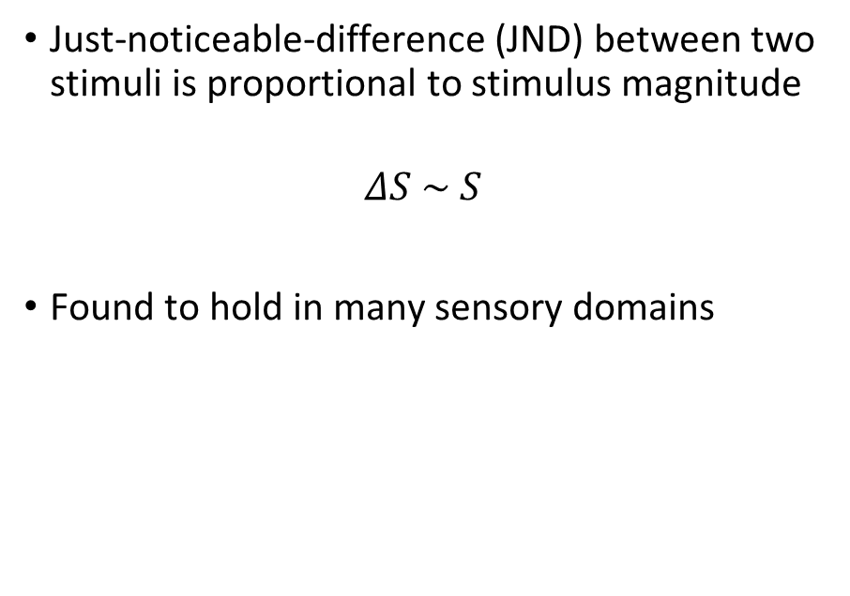
Weber’s law
Just-noticeable-difference (JND) between two stimuli is proportional to stimulus magnitude
$$ΔS \sim S$$
Found to hold in many sensory domains
0.7 cm
9.0 cm
1.2 cm
9.5 cm
Fechner (1860), Baird (1970), Teghtsoonian (1971)
Source: Wikipedia
Notes:
Be brief with lines

Slide 4
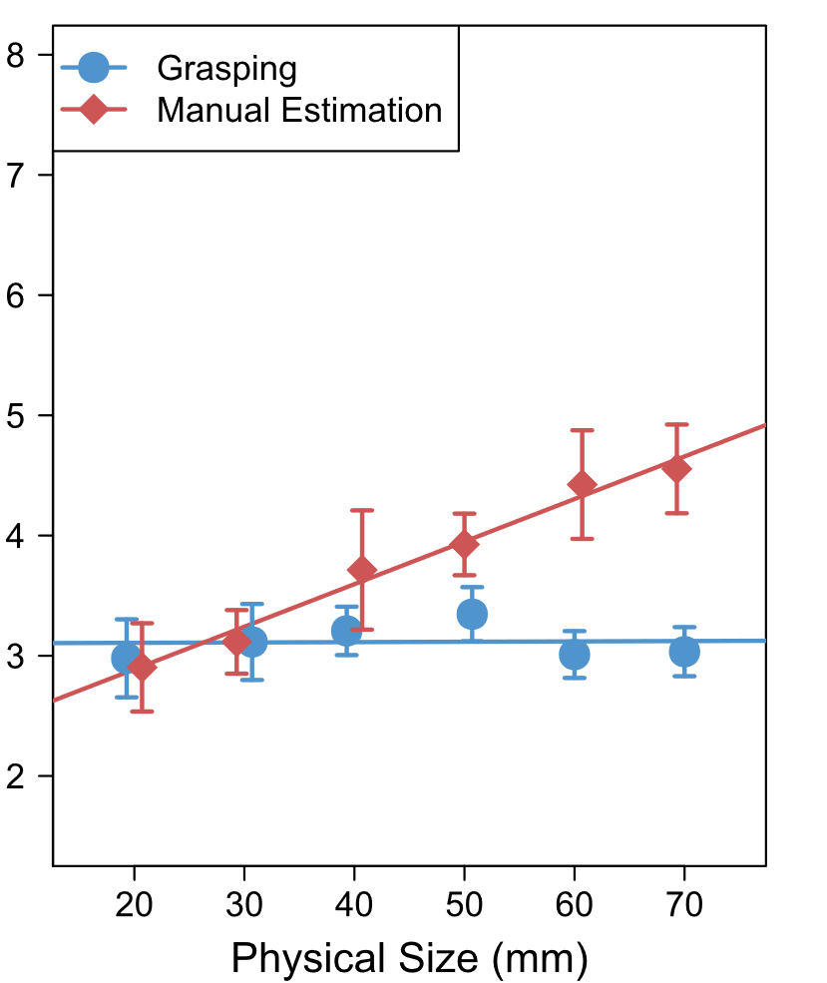
Weber’s Law in grasping
Many studies concluded:
  adherence to Weber’s law in manual estimation of object size (perceptual)
  violation of Weber’s law in grasping objects of different sizes
  Different processing of action vs. perception?
Ganel, Chajut, Algom (2008)
JND (mm)
  Why should grasping violate Weber’s law?
Ganel et al. (2008), Smeets & Brenner (2008), Heath et al. (2011)

Slide 5
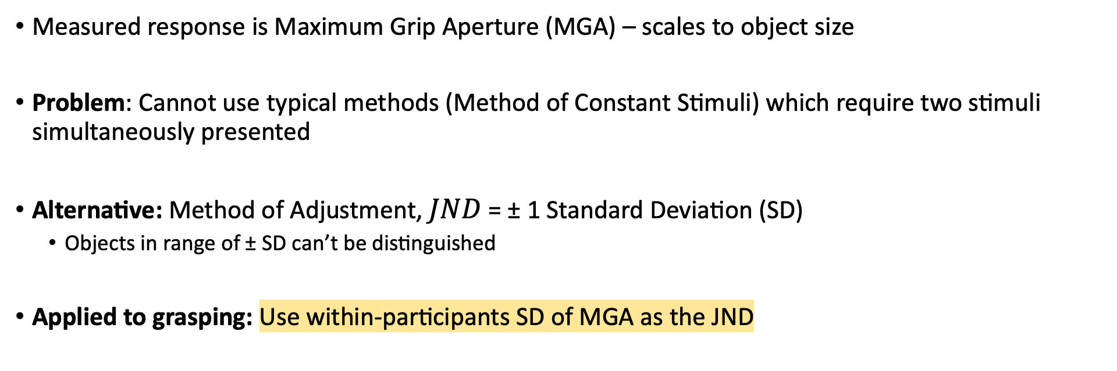
How is JND calculated in grasping?
Measured response is Maximum Grip Aperture (MGA) – scales to object size
Problem: Cannot use typical methods (Method of Constant Stimuli) which require two stimuli simultaneously presented
Alternative: Method of Adjustment, $JND$ = ± 1 Standard Deviation (SD)
  Objects in range of ± SD can’t be distinguished
Applied to grasping: Use within-participants SD of MGA as the JND
Baird & Noma (1978)
Ganel, Chajut, Algom (2008)

Slide 6
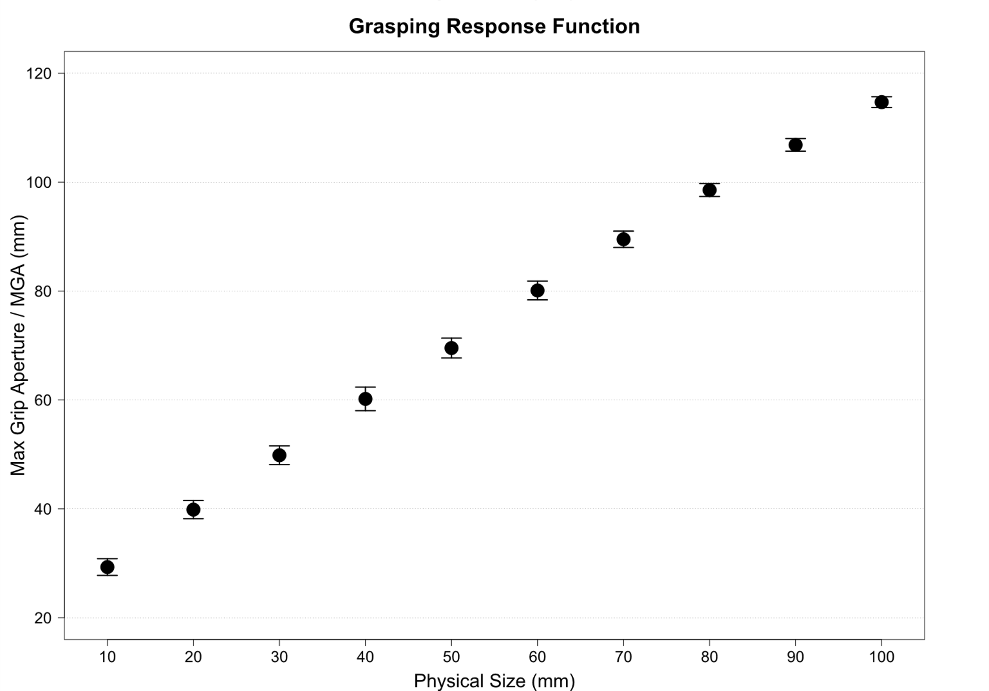
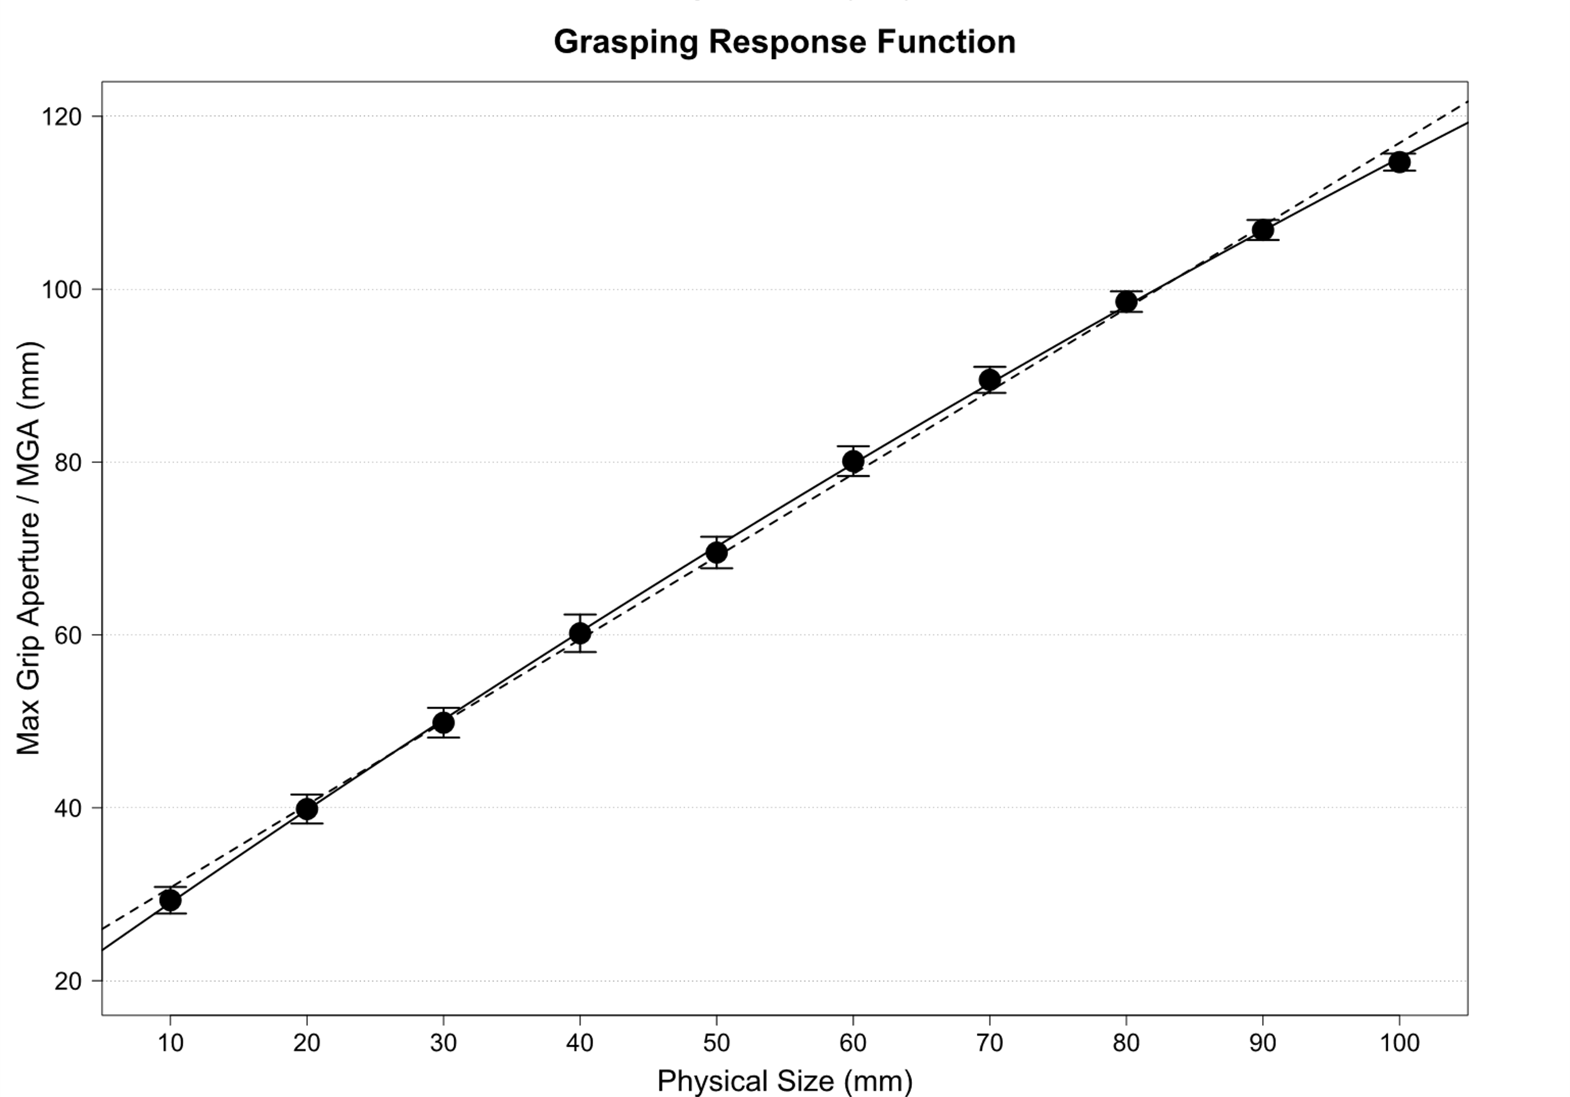

The problem with using SD as proxy to JND
Non-linear response function in grasping
This small non-linearity has an impact on using SD as the JND
May be due to biomechanical limits
Utz et al. (2015)
Bruno et al. (2016)
Uccelli et al. (2021)
Hesse & Franz (2009)

Slide 7
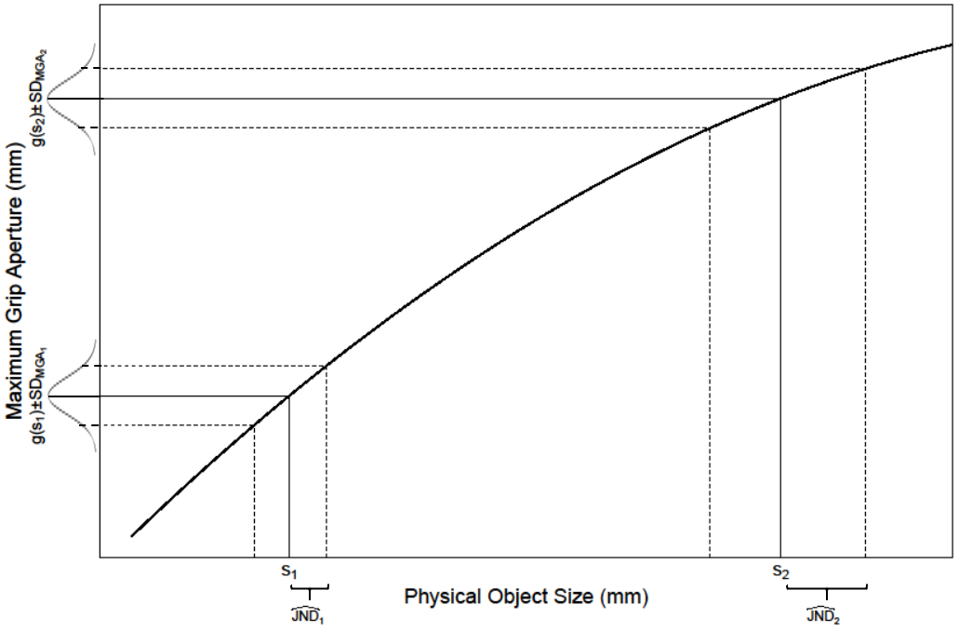
SD underestimates JND at large sizes
Exaggerated nonlinearity
JND = range of object sizes with same MGA
At small sizes JND linearly related to SD
Larger JNDs at large sizes are underestimated by SD
Equal SD_{MGA} does not mean equal JND

Slide 8
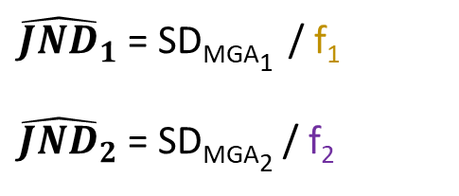
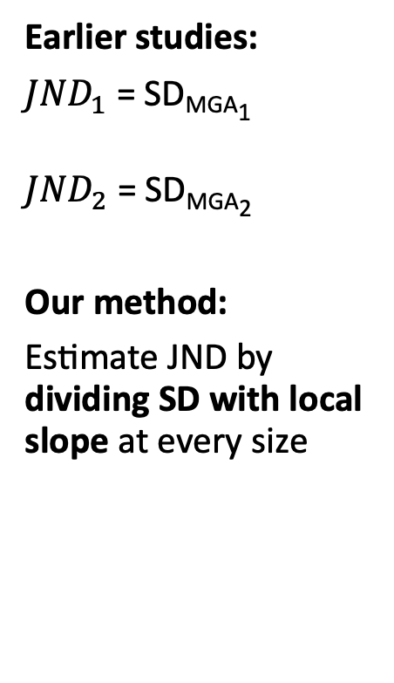
Accounting for non-linearity
Slope f₂
Earlier studies:
${JND}_{1}$ = SD_{MGA1}
${JND}_{2}$ = SD_{MGA2}
Our method:
Estimate JND by dividing SD with local slope at every size
Slope f₁
${\hat{JND}}_{1}$ = SD_{MGA1} / f₁
${\hat{JND}}_{2}$ = SD_{MGA2} / f₂

Slide 9



Methods
Replication
Reanalyses
Experiment 1
20 participants
Löwenkamp et al. (2015)
Our own group’s previous paper
50 trials/size
Replication
Heath
et al. (2011)
Other group’s highly-cited paper
20 – 50 mm
Ganel
et al. (2008)
First study on this topic
Thank you to Prof. Tzvi Ganel for sharing his data with us!
Grasping
Manual Estimation

Slide 10
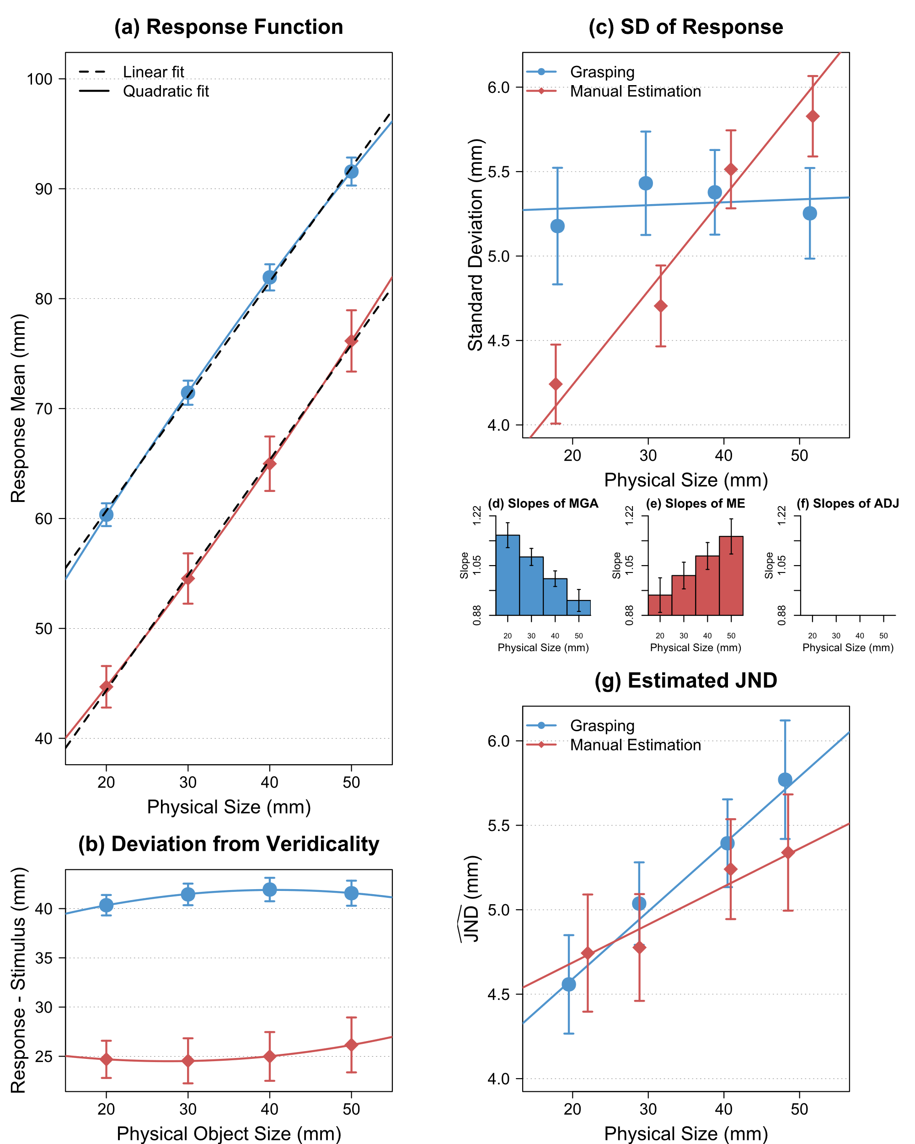
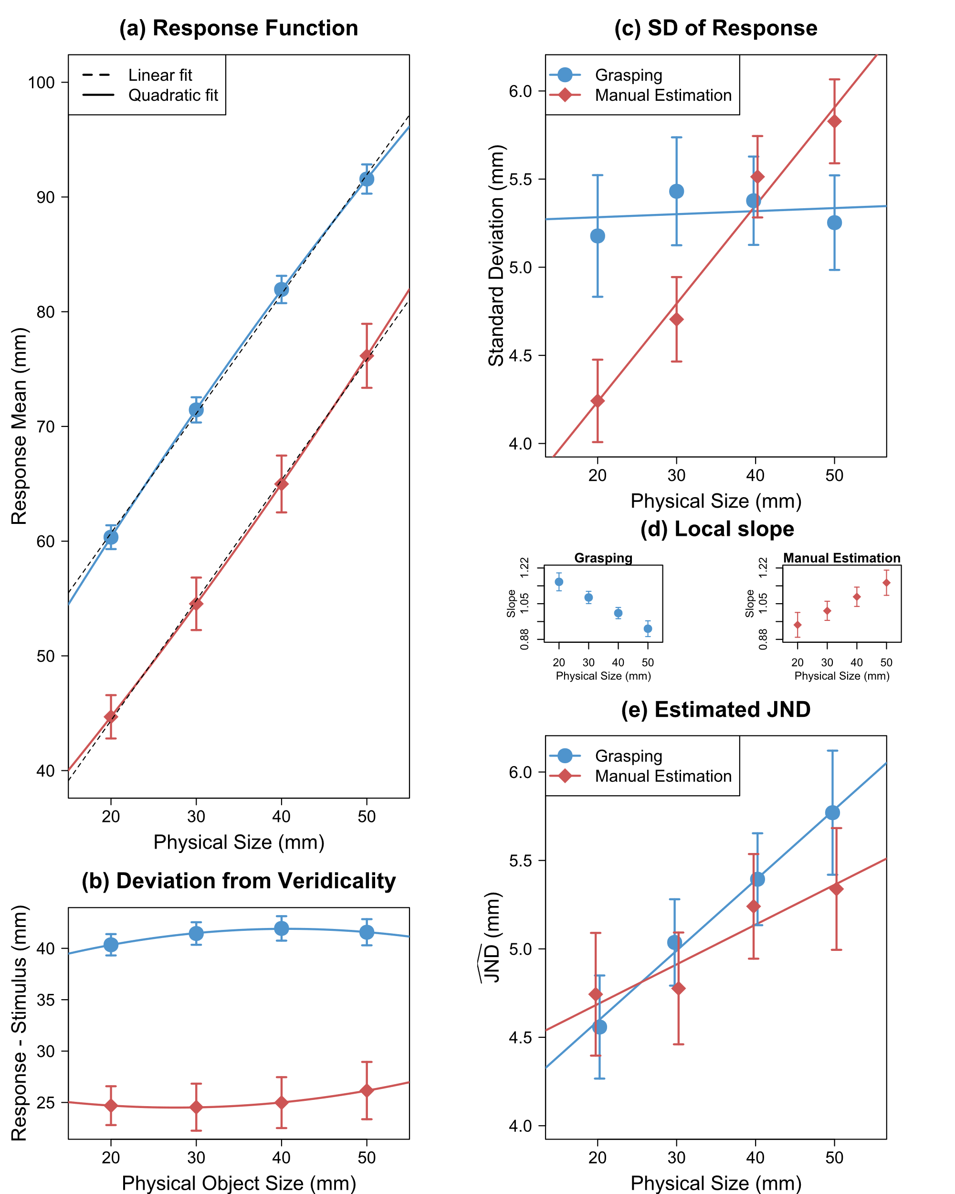
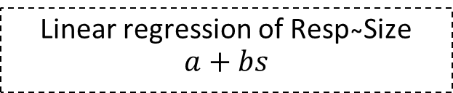
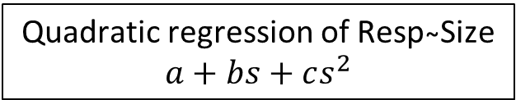
Results: Experiment 1
Local slopes (f_{s})
Linear regression of Resp ̴Size
$$a+bs$$
Response (mm)
Quadratic regression of Resp ̴Size
$$a+bs+cs^{2}$$
10

Slide 11
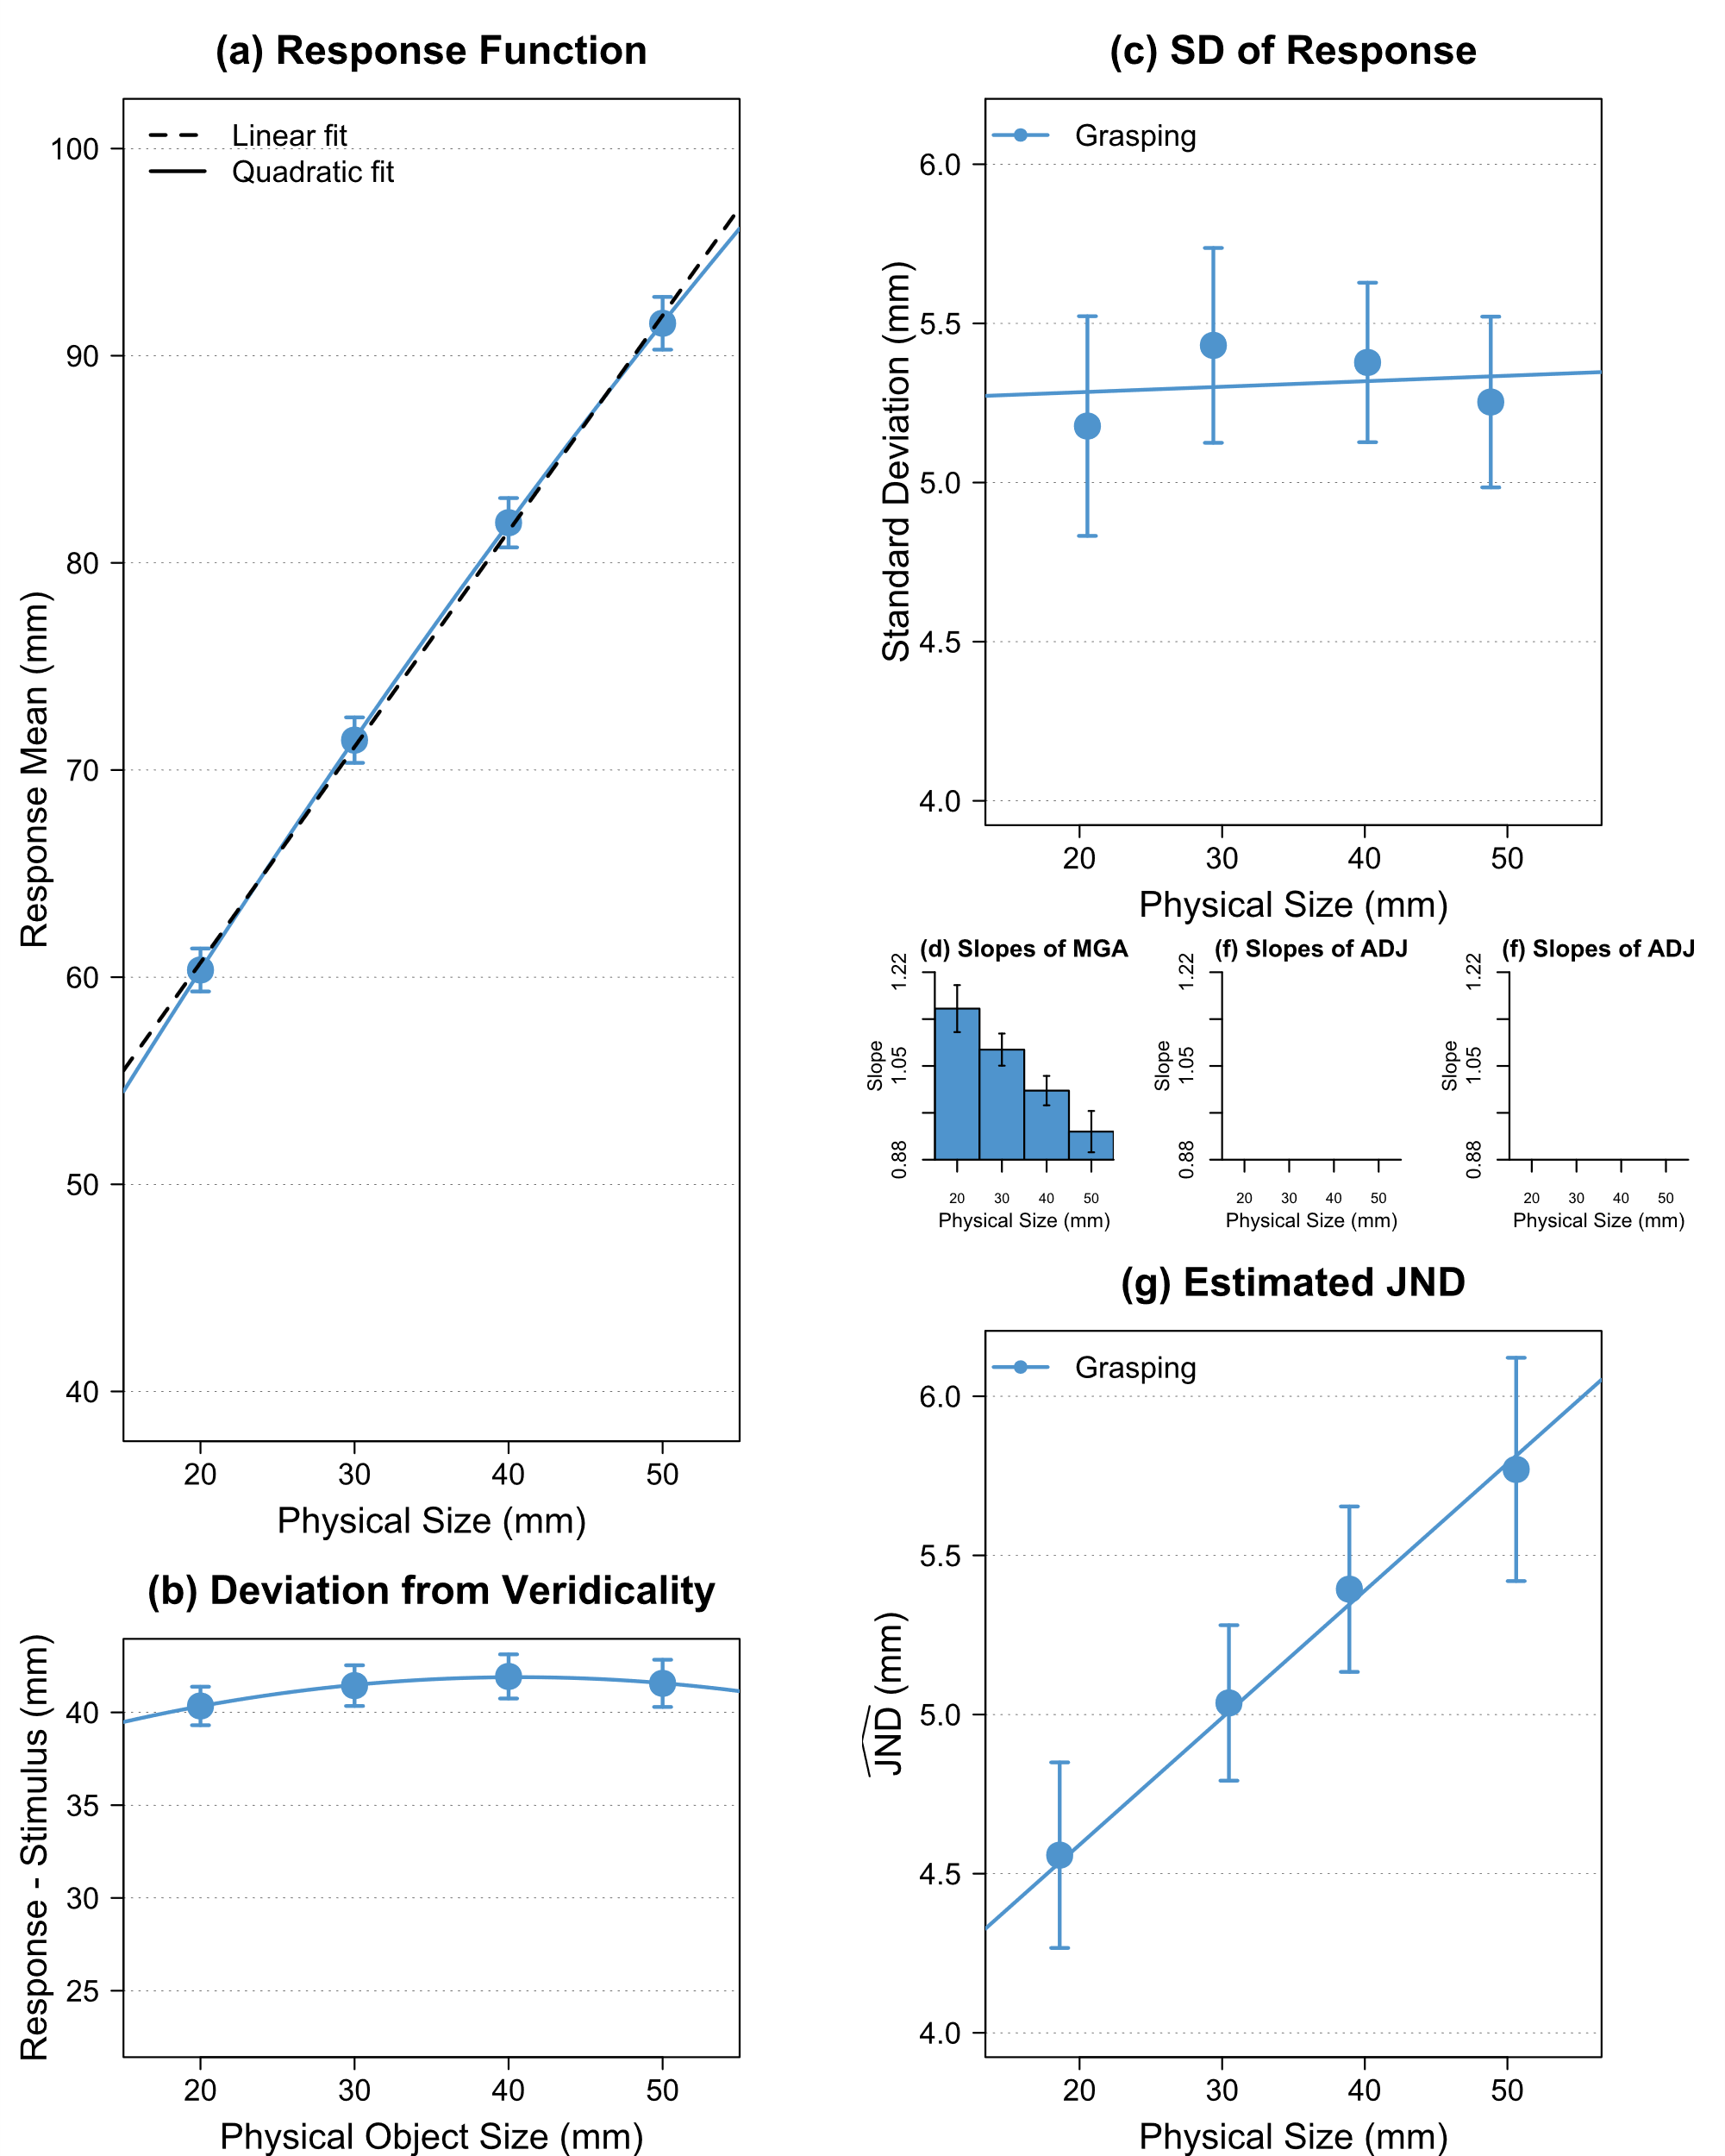

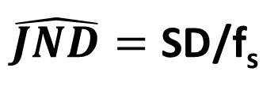

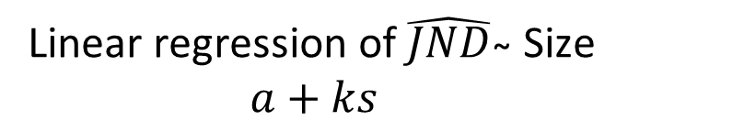
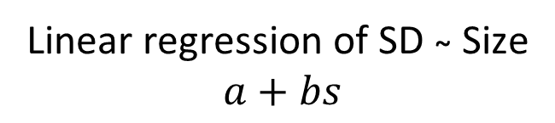
Results: Experiment 1
Linear regression of SD ̴ Size
$$a+bs$$
Linear regression of $\hat{JND}$ ̴ Size
$$a+ks$$
$\hat{JND}=\text{SD}$/f_{s}
Weber constant!
$$k$$

Slide 12

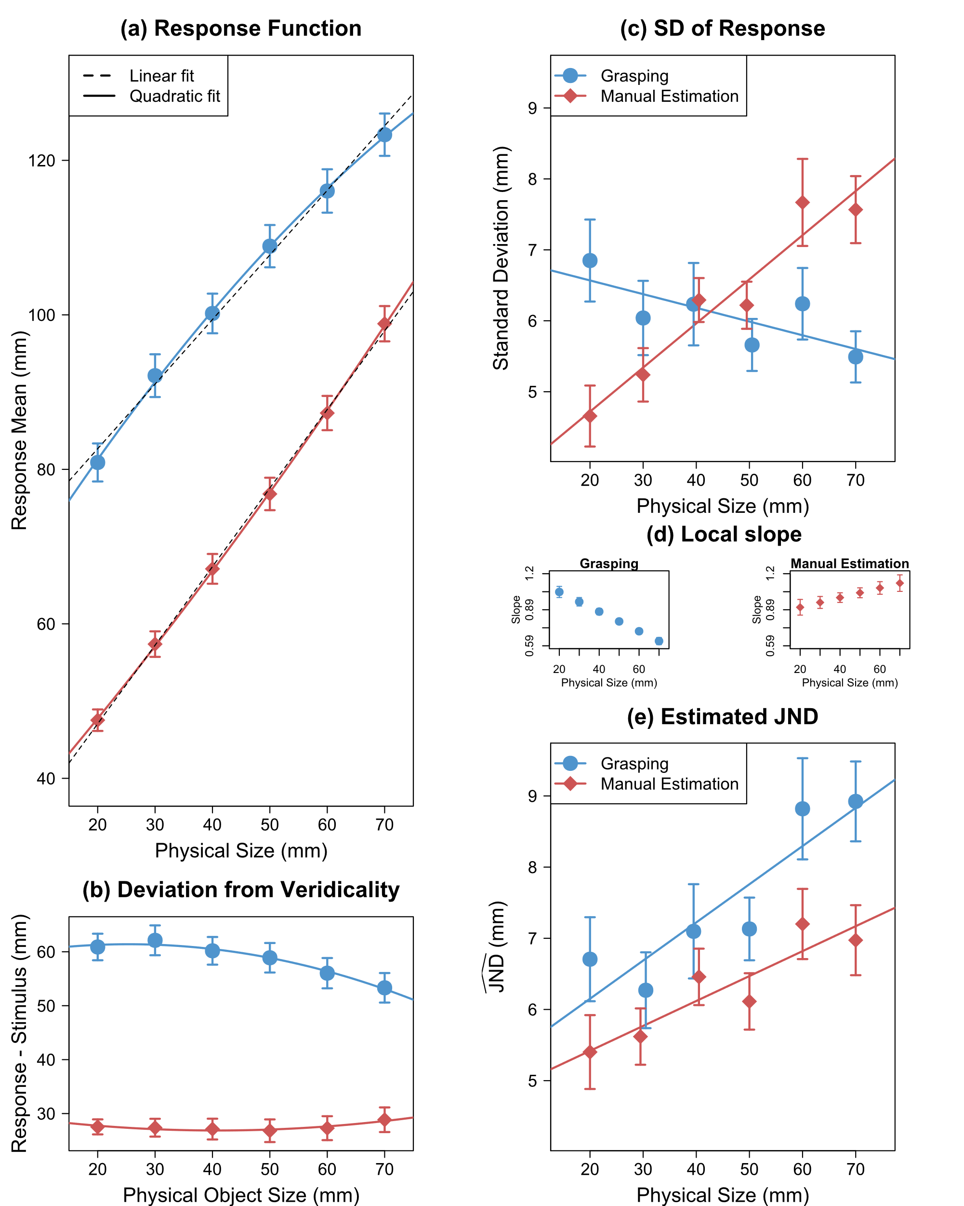
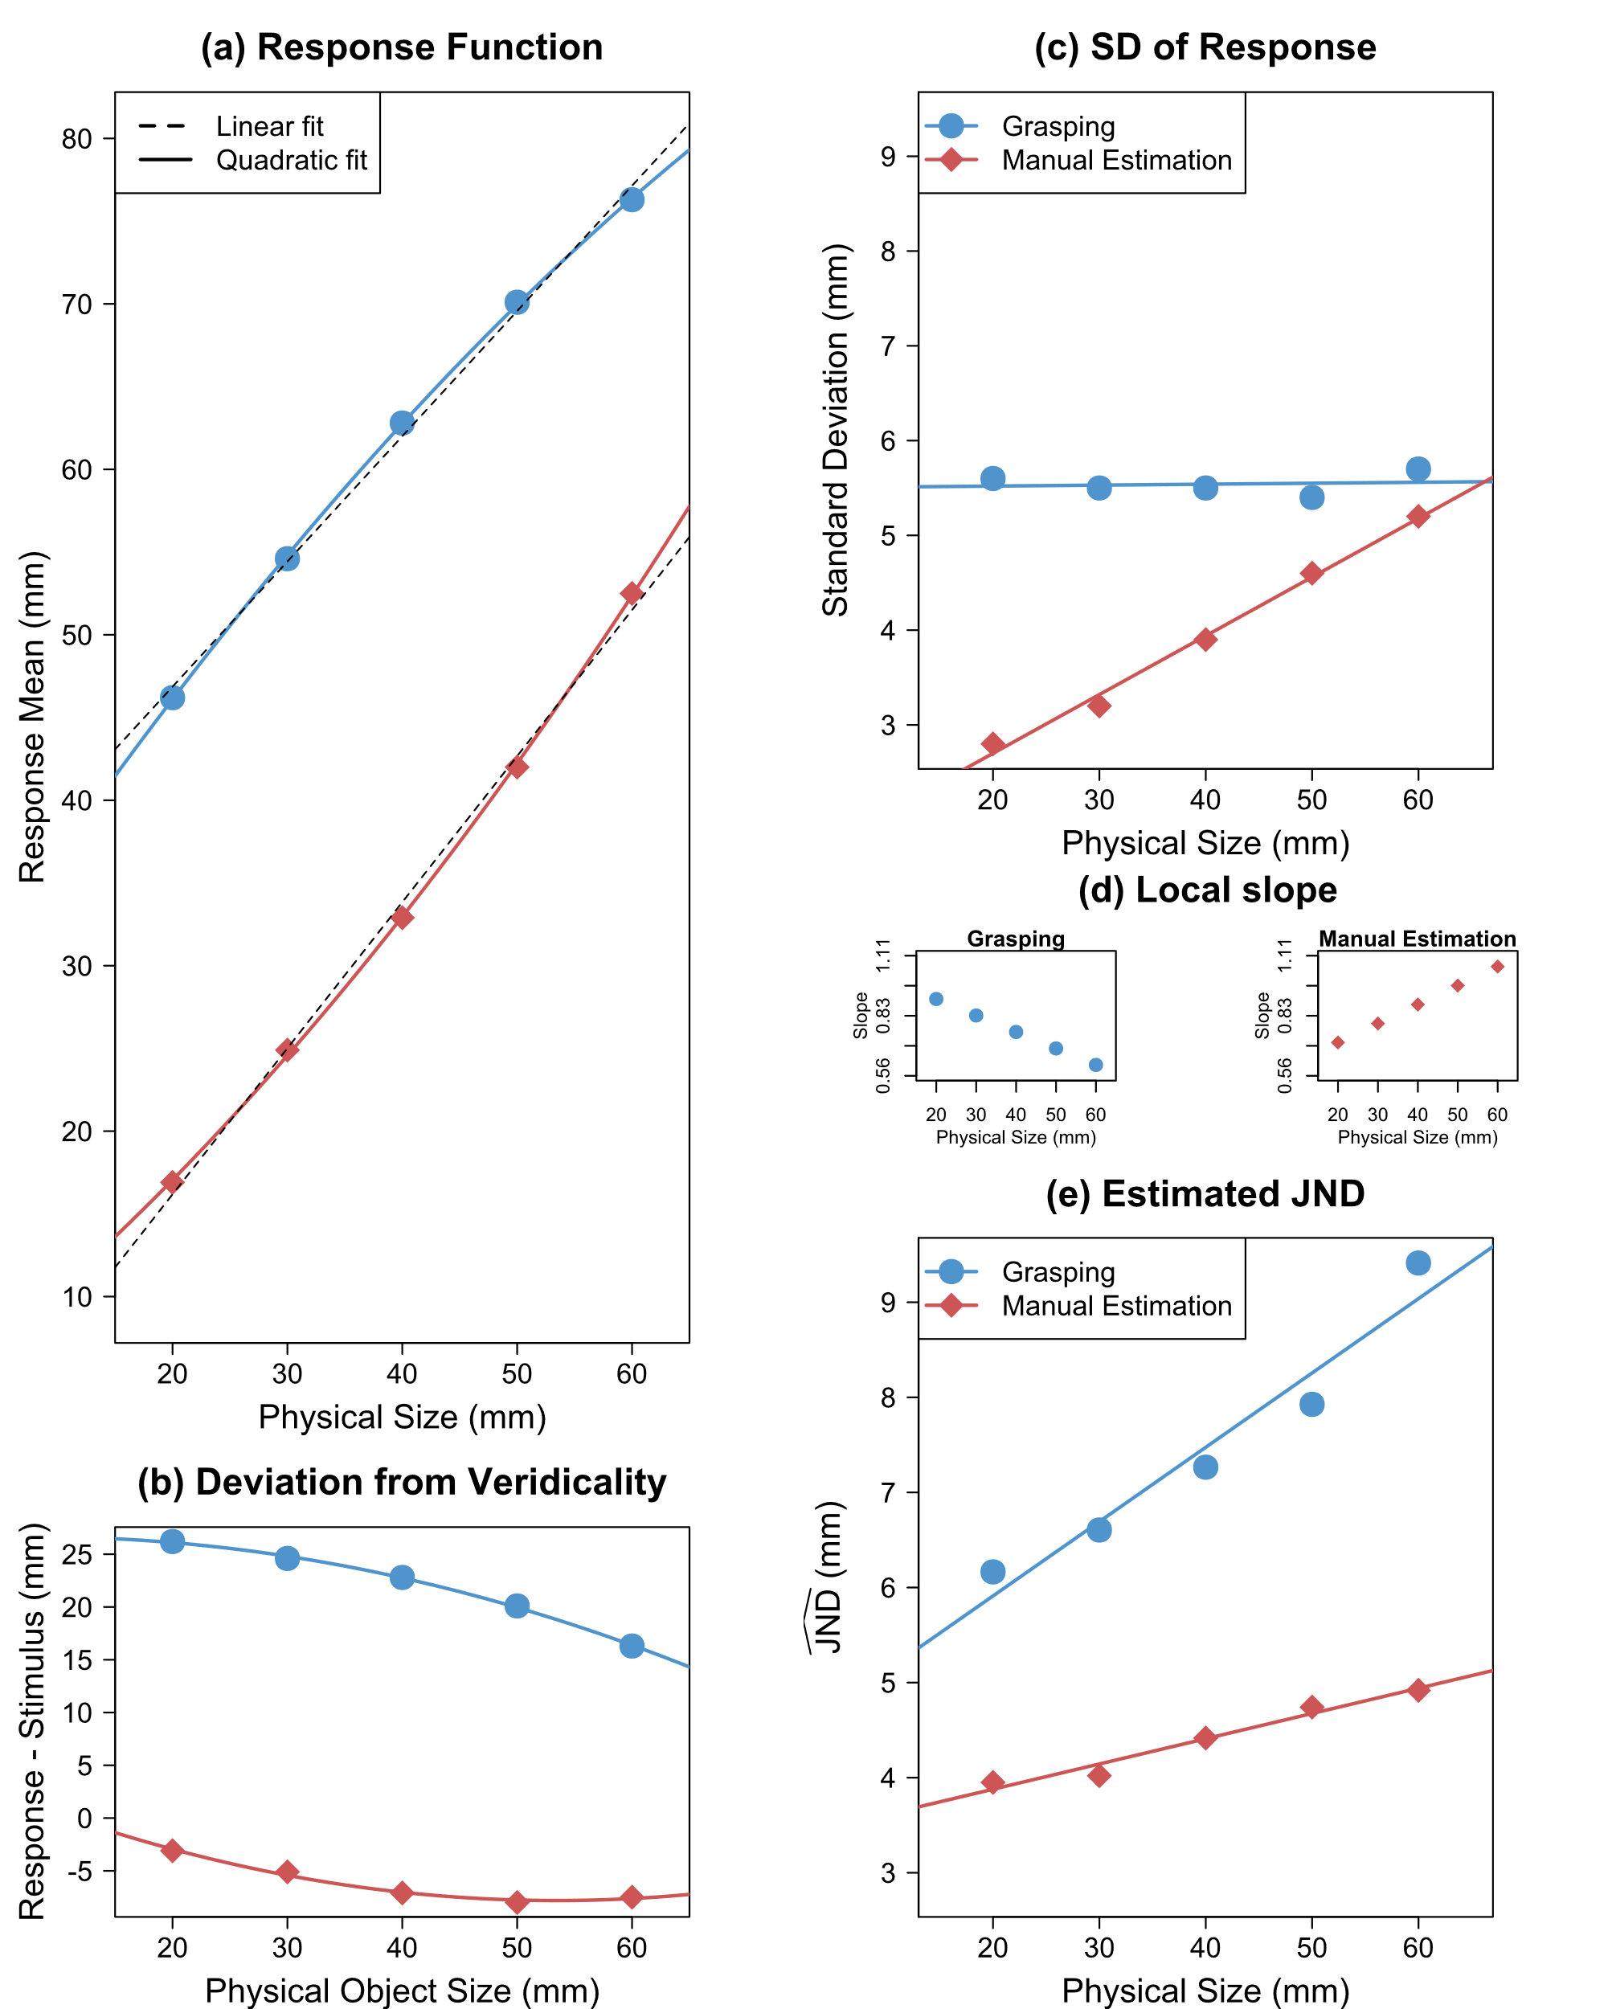
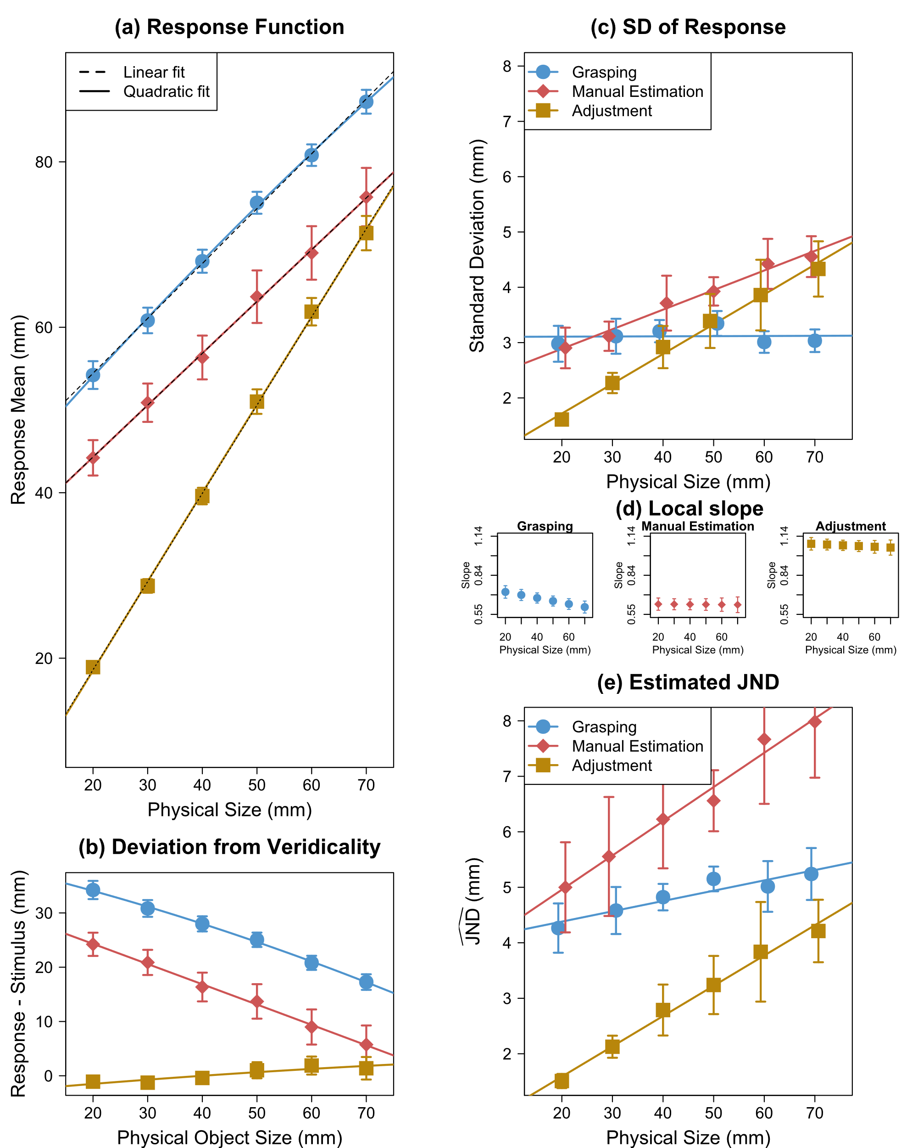

Reanalysis of three influential studies
Only summary data available
Heath et al. (2011)
Exp 1 (2022)
Löwenkamp et al. (2015)
Ganel et al. (2008)
SD
$$\hat{JND}$$
Notes:
Don’t describe JND again

Slide 13
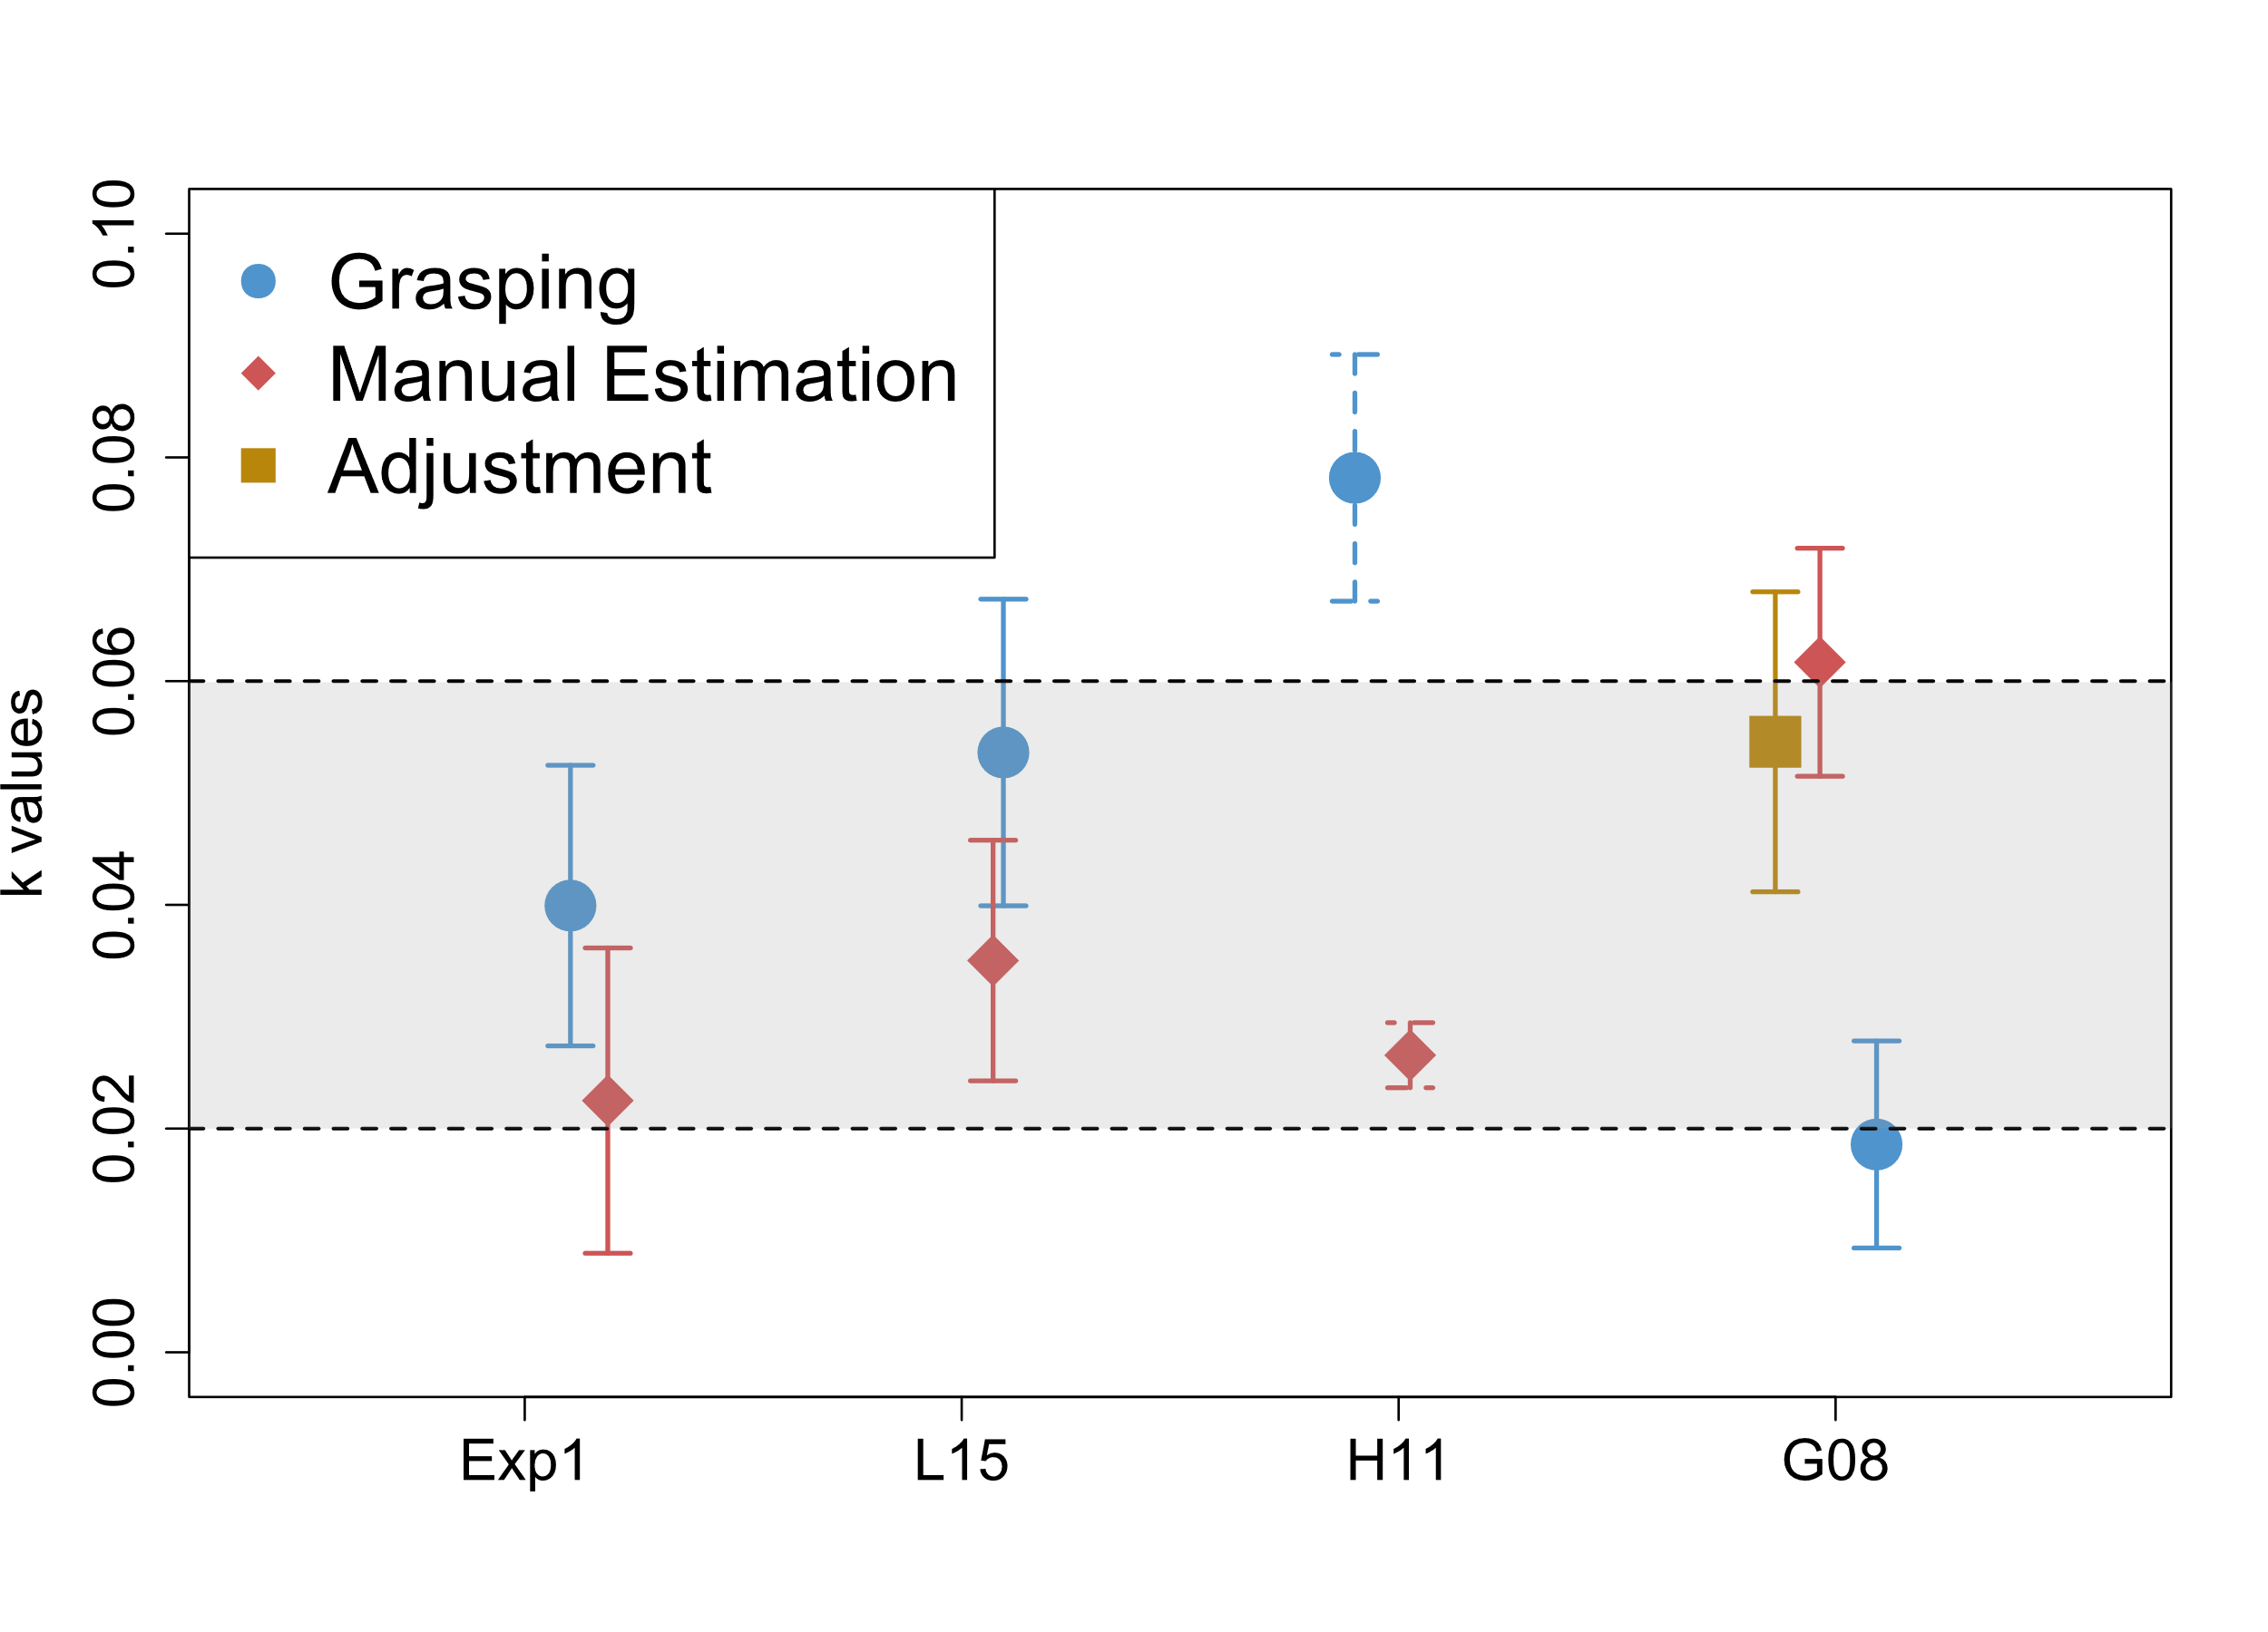
Comparison to Weber constants (k) from size perception
Exp 1
(2022)
Löwenkamp et al.
(2015)
Heath et al.
(2011)
Ganel et al. (2008)
Expected values of k from studies on size perception: 0.02 – 0.06
Teghtsoonian (1971), McKee & Welch (1992)

Slide 14
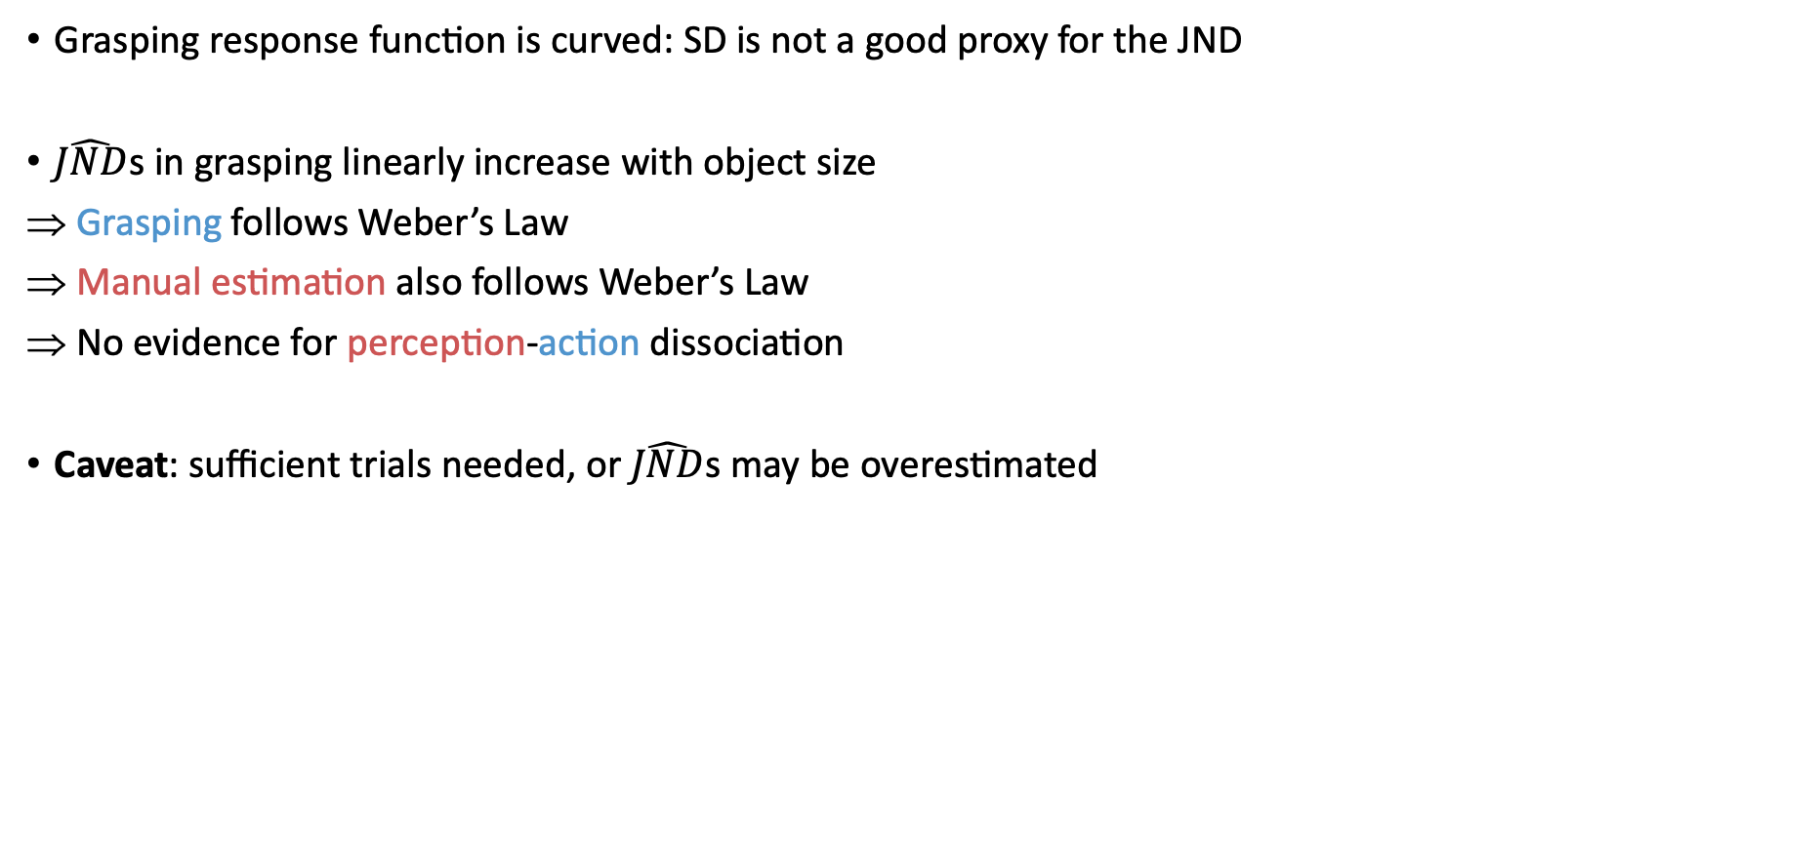
Discussion
Grasping response function is curved: SD is not a good proxy for the JND
$\hat{JND}$s in grasping linearly increase with object size
Grasping follows Weber’s Law
Manual estimation also follows Weber’s Law
No evidence for perception-action dissociation
Caveat: sufficient trials needed, or $\hat{JND}$s may be overestimated
Take-home message:
We need to account for non-linearity by dividing SDs with the local slopes.
Grasping follows Weber’s Law!

Slide 15
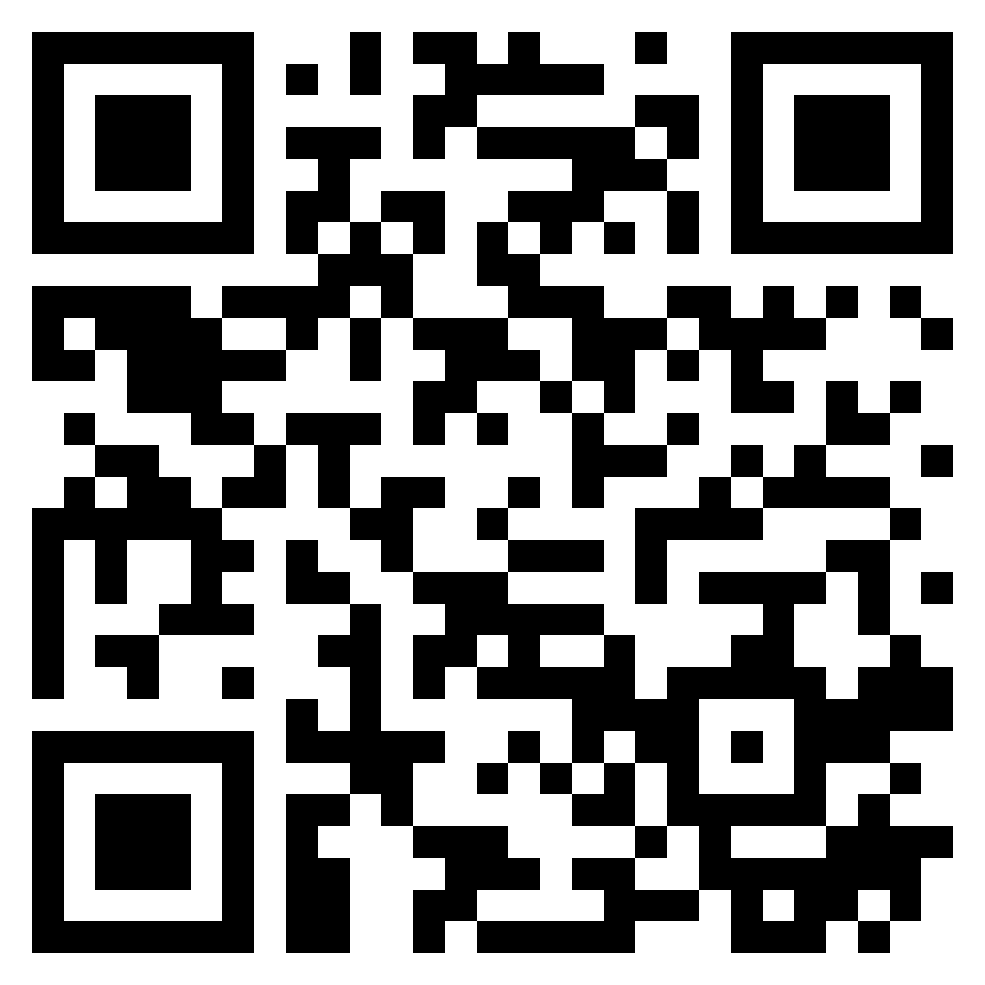
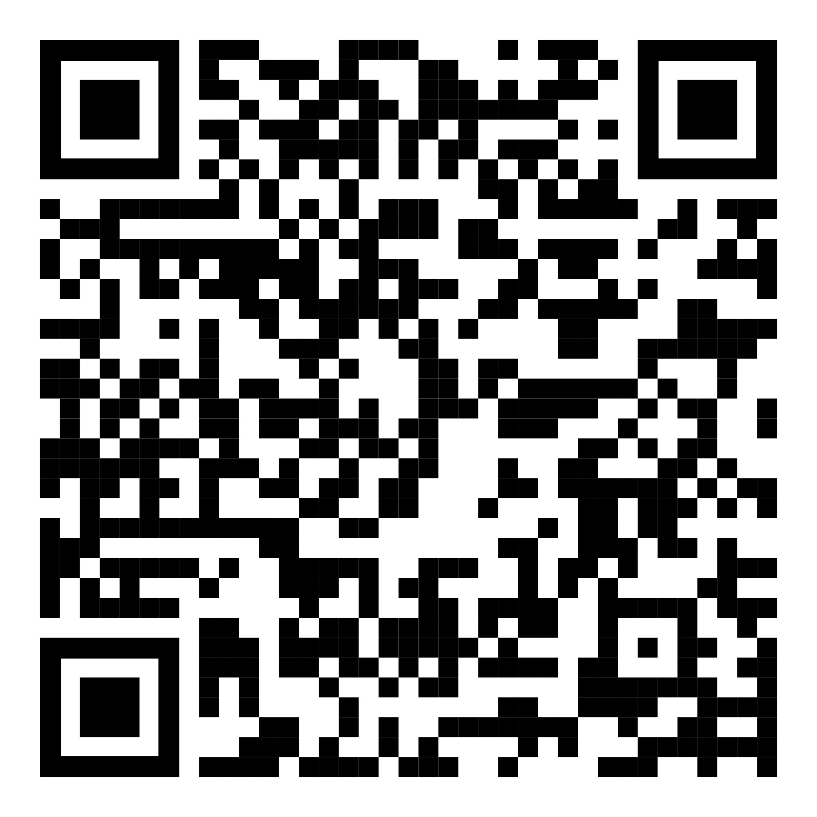
Thanks for your interest!
Publication
Christian Löwenkamp collected the data and designed the analyses
Slides
Thank you to Prof. Tzvi Ganel for sharing his data with us!
Local slopes
Exp1 (2022)
Slope f₂
Slope f₁

Slide 16
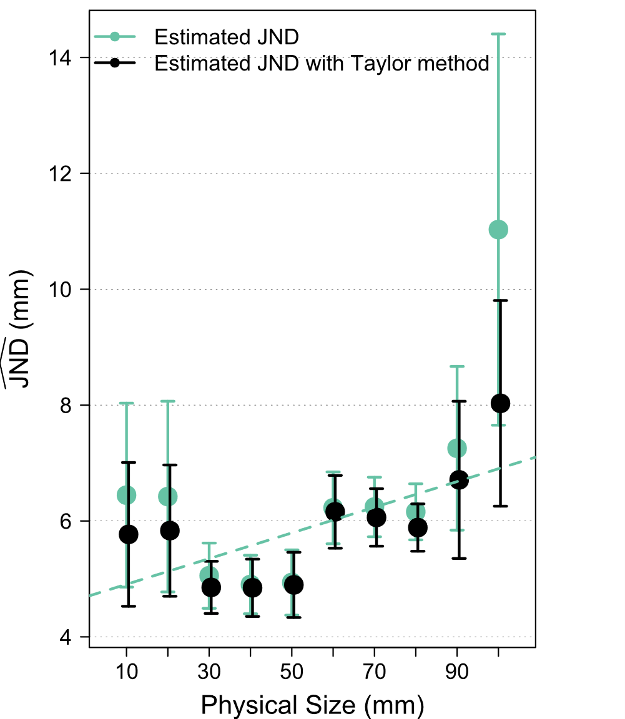
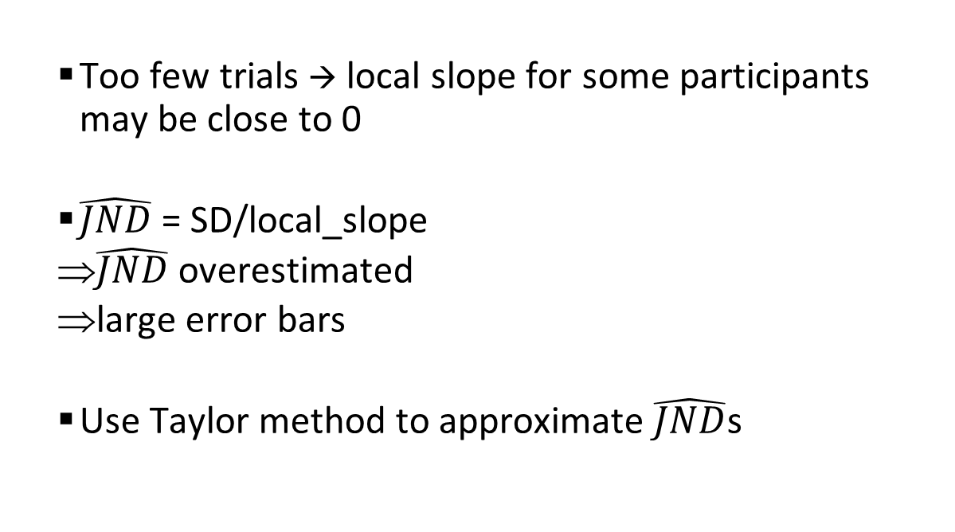
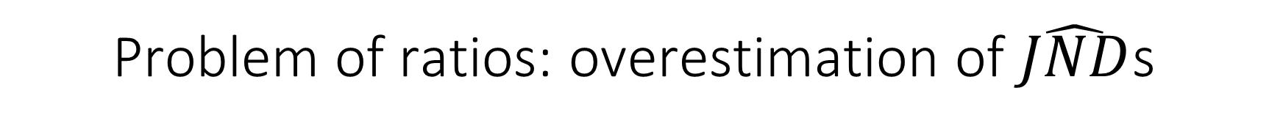
Problem of ratios: overestimation of $\hat{JND}$s
Trials per object size = 10
  Too few trials → local slope for some participants may be close to 0
  $\hat{JND}$= SD/local_slope
  $\hat{JND}$ overestimated
  large error bars
  Use Taylor method to approximate $\hat{JND}$s
von Luxburg & Franz (2009)
Franz (2007, arXiv preprint)
Hesse & Franz (2009)

Slide 17
Full data vs. Aggregate data analyses
Ganel et al. (2008)
Task | Full data | Aggregate data
Grasping | 0.019 ± 0.009 | 0.016 ± 0.005
Manual Estimation | 0.062 ± 0.022 | 0.057 ± 0.005
Perceptual adjustment | 0.055 ± 0.012 | 0.052 ± 0.002

