Slide 1


Perception-Action Dissociations in Garner Interference
Kriti Bhatia¹, Angela Osenberg¹, Markus Janczyk², Volker H. Franz¹
¹University of Tübingen, Germany
²University of Bremen, Germany
Funded by the Deutsche Forschungsgemeinschaft (DFG – German Research Foundation) within the Research Unit FOR2718: Modal and Amodal Cognition.

Slide 2

Garner’s Speeded-classification Task
Garner & Felfoldy (1970); Garner (1970); Felfoldy (1974)
Multi-dimensional stimuli like rectangles
Dimensions are length and width
Task-relevant and task-irrelevant dimensions
WIDE
or
NARROW?
Baseline
A
C
WIDTH
Block 1
Block 2
B
D
Garner Interference
Filtering
= RT_{filtering} - RT_{baseline}
LENGTH
Notes:
To investigate this, they applied an experimental paradigm called the Garner Task. Multidimensional stimuli, like here rectangles with the dimensions length and width, are presented one at a time. The width is the task-relevant dimension, so participants judge them as “wide” or “narrow”. They are presented in two separate conditions, the baseline where only the width differs, and the filtering where length and width both differ. Reaction times are measured, and the typical result is that RTs in the baseline are shorter than filtering, and this is Garner interference, because the task irrelevant dimension, the length, interferes with the judgement about the width.

Slide 3
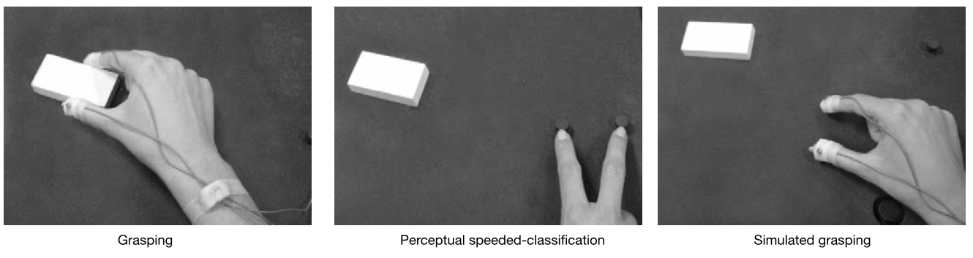
Garner Interference in Perception and Action
Ganel & Goodale (2003, Nature)
Experiment 1
N = 12
Grasping
Perception
(Perceptual speeded-classification)

Slide 4
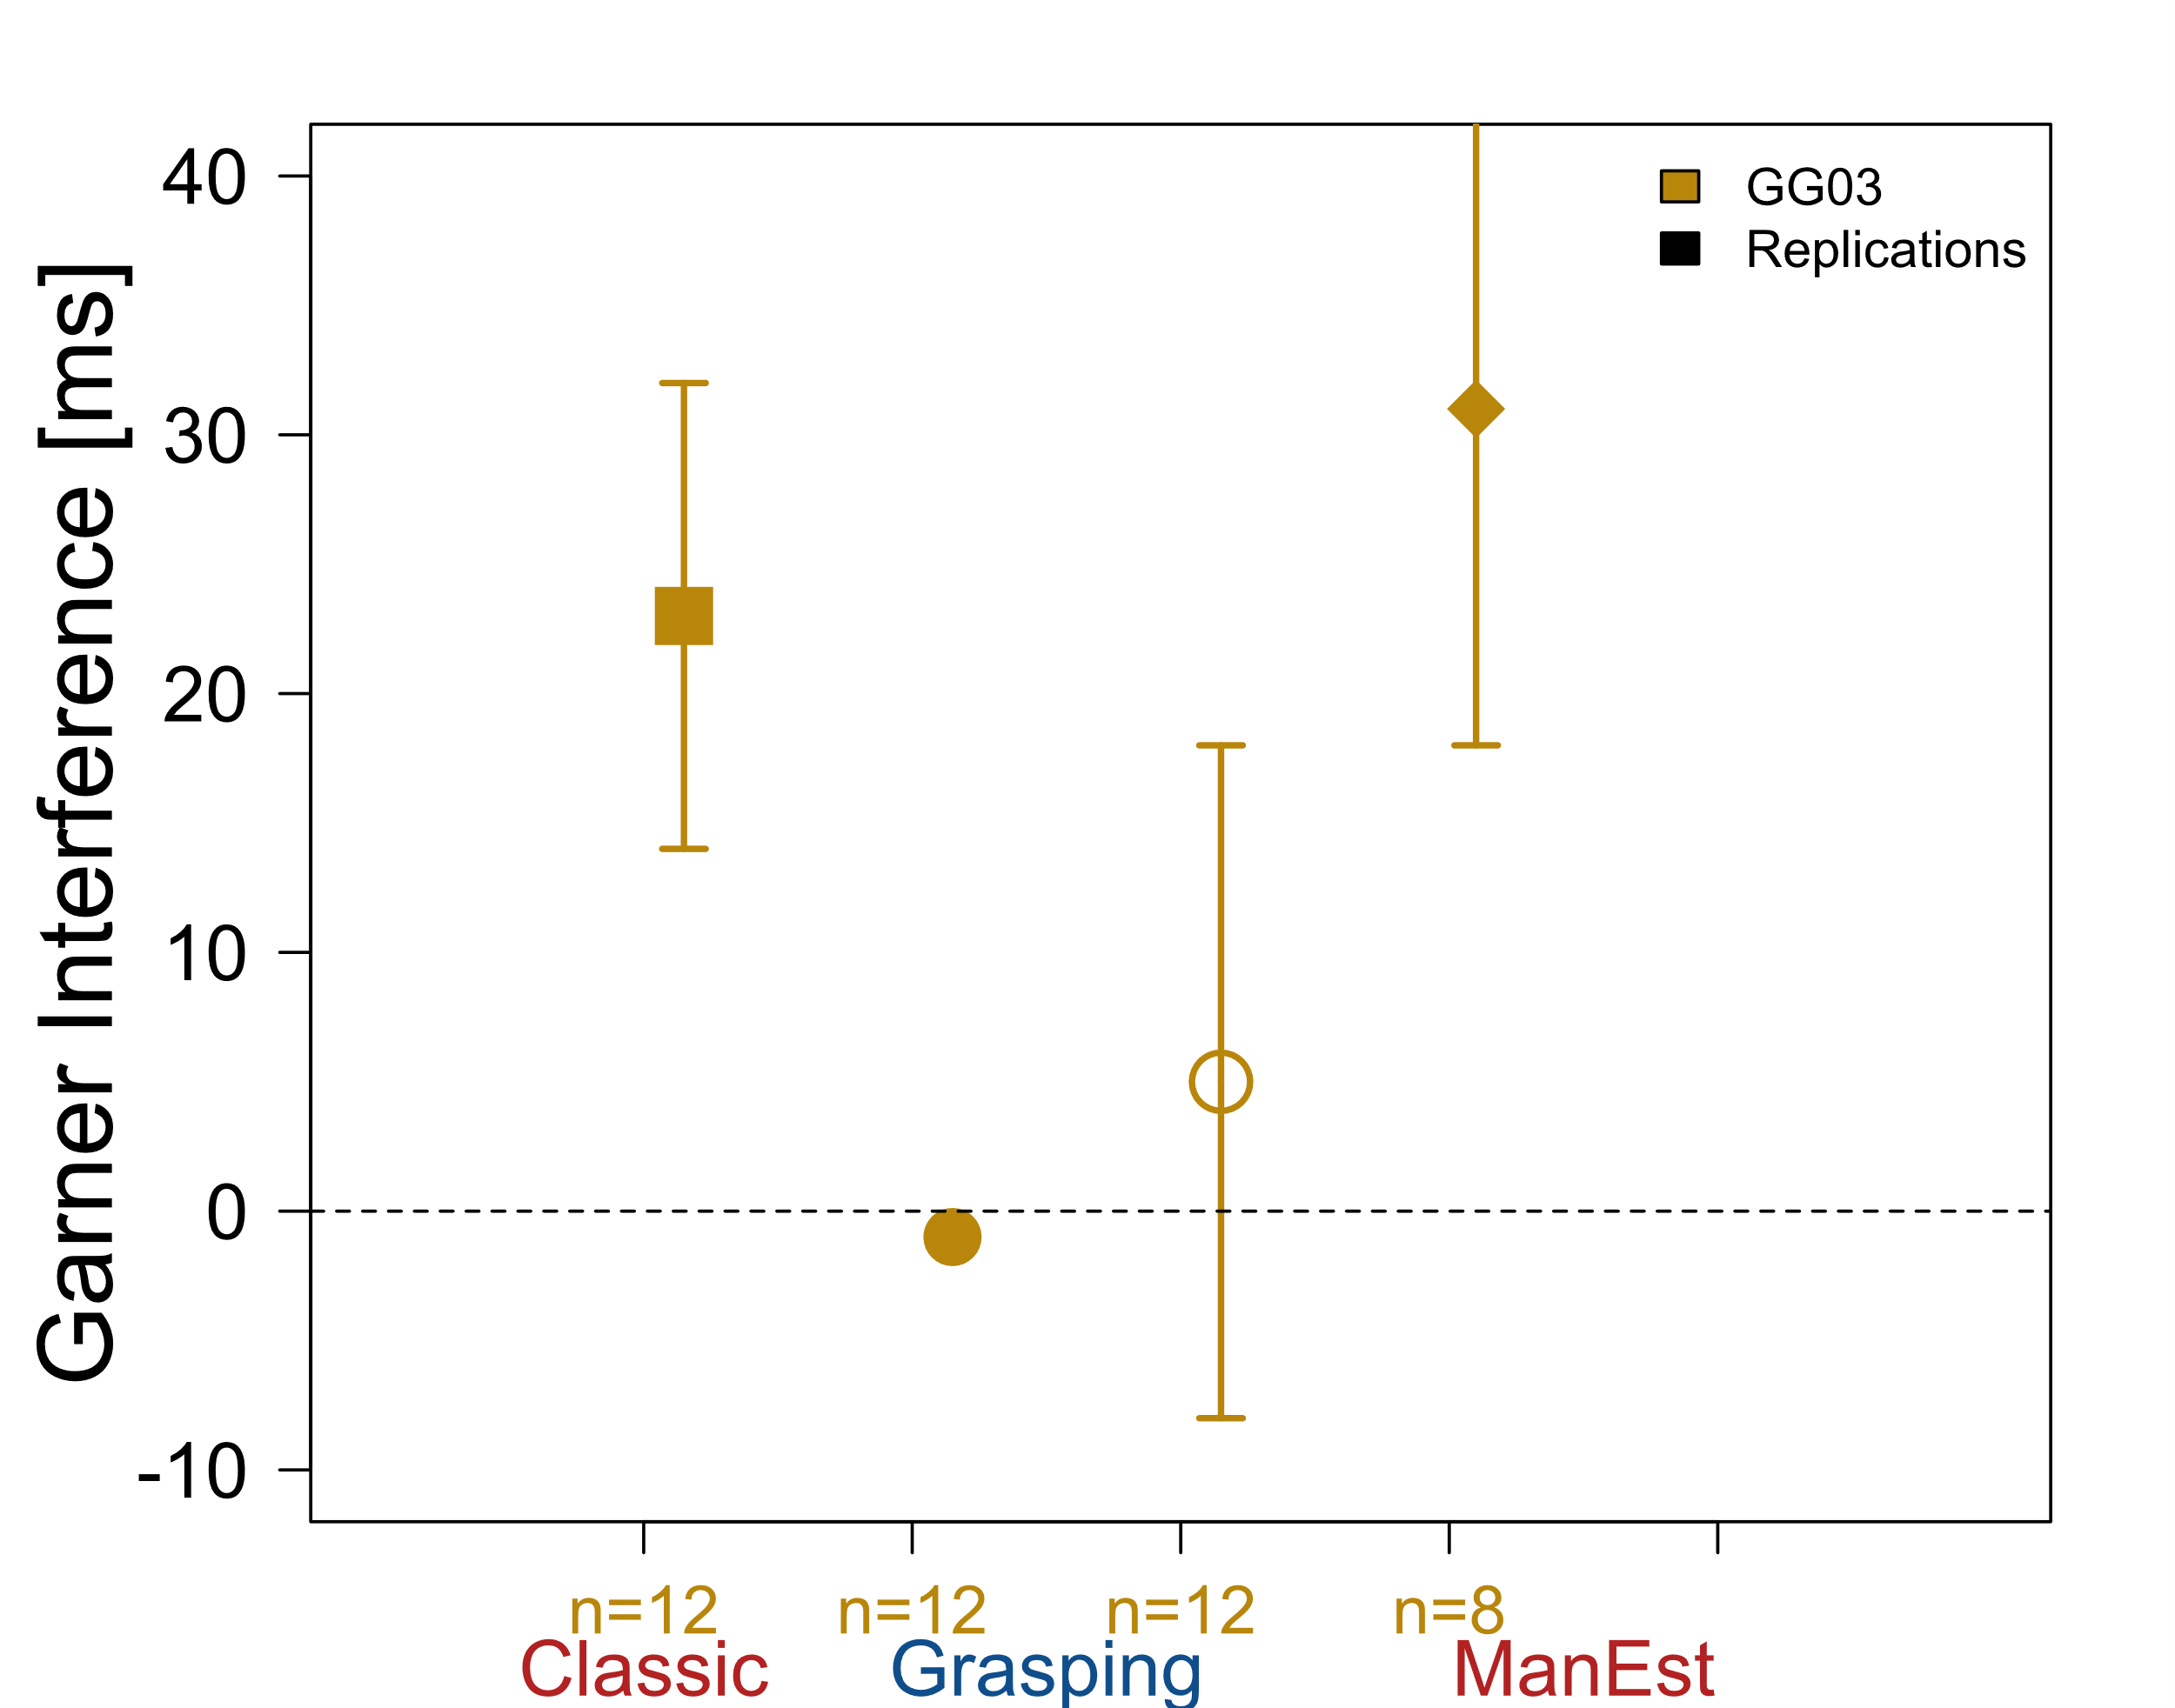

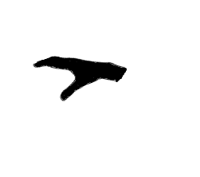
Garner Interference in Perception and Action
Control
Ganel & Goodale (2003, Nature)
Exp 1
n = number of participants in task

Slide 5
Garner Interference in Perception and Action
Ganel & Goodale (2003, Nature)
Experiment 1
N = 12
Grasping
⬄
Similar task demands!
Comparable tasks
Manual Estimation
Perception
(Perceptual speeded-classification)
Experiment 2
N = 8
“manual read-out of what participants perceive”
(Haffenden & Goodale, 1998, p.25, J. Cogn. Neurosci.)

Slide 6

Garner Interference in Perception and Action
Control
Ganel & Goodale (2003, Nature)
Exp 1
Exp 2
The processing of perception and action is fundamentally different
n = number of participants in task

Slide 7
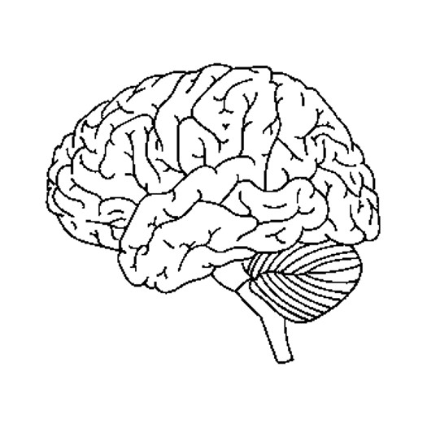
Perception-Action Model (PAM)
Goodale & Milner (1992)
  Separate and parallel ventral and dorsal streams
  Different processing in perception versus action
  Experiments on brain-lesion patients
  Supporting evidence from healthy humans
Visuomotor Actions
Dorsal
V1
Ventral
Visual Perception

Slide 8
Garner Interference in Perception and Action
Control
Ganel & Goodale (2003, Nature)
Exp 1
Exp 2
The processing of perception and action is fundamentally different
grasping vs. manual estimation
similar task demands
different processing
n = number of participants in task

Slide 9
Review of Garner Effects
Acquired and compiled data from 10 studies on Garner interference

Slide 10
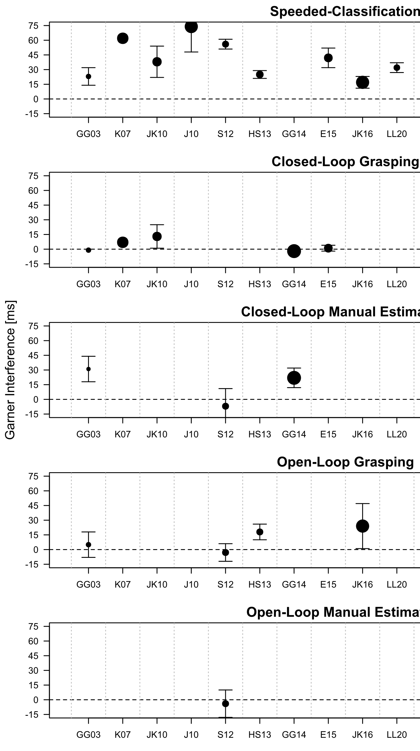

Literature Review: Reaction Time
Number of studies
9
5
Closed-Loop Manual Estimation
3
4
Open-Loop Manual Estimation
1

Slide 11
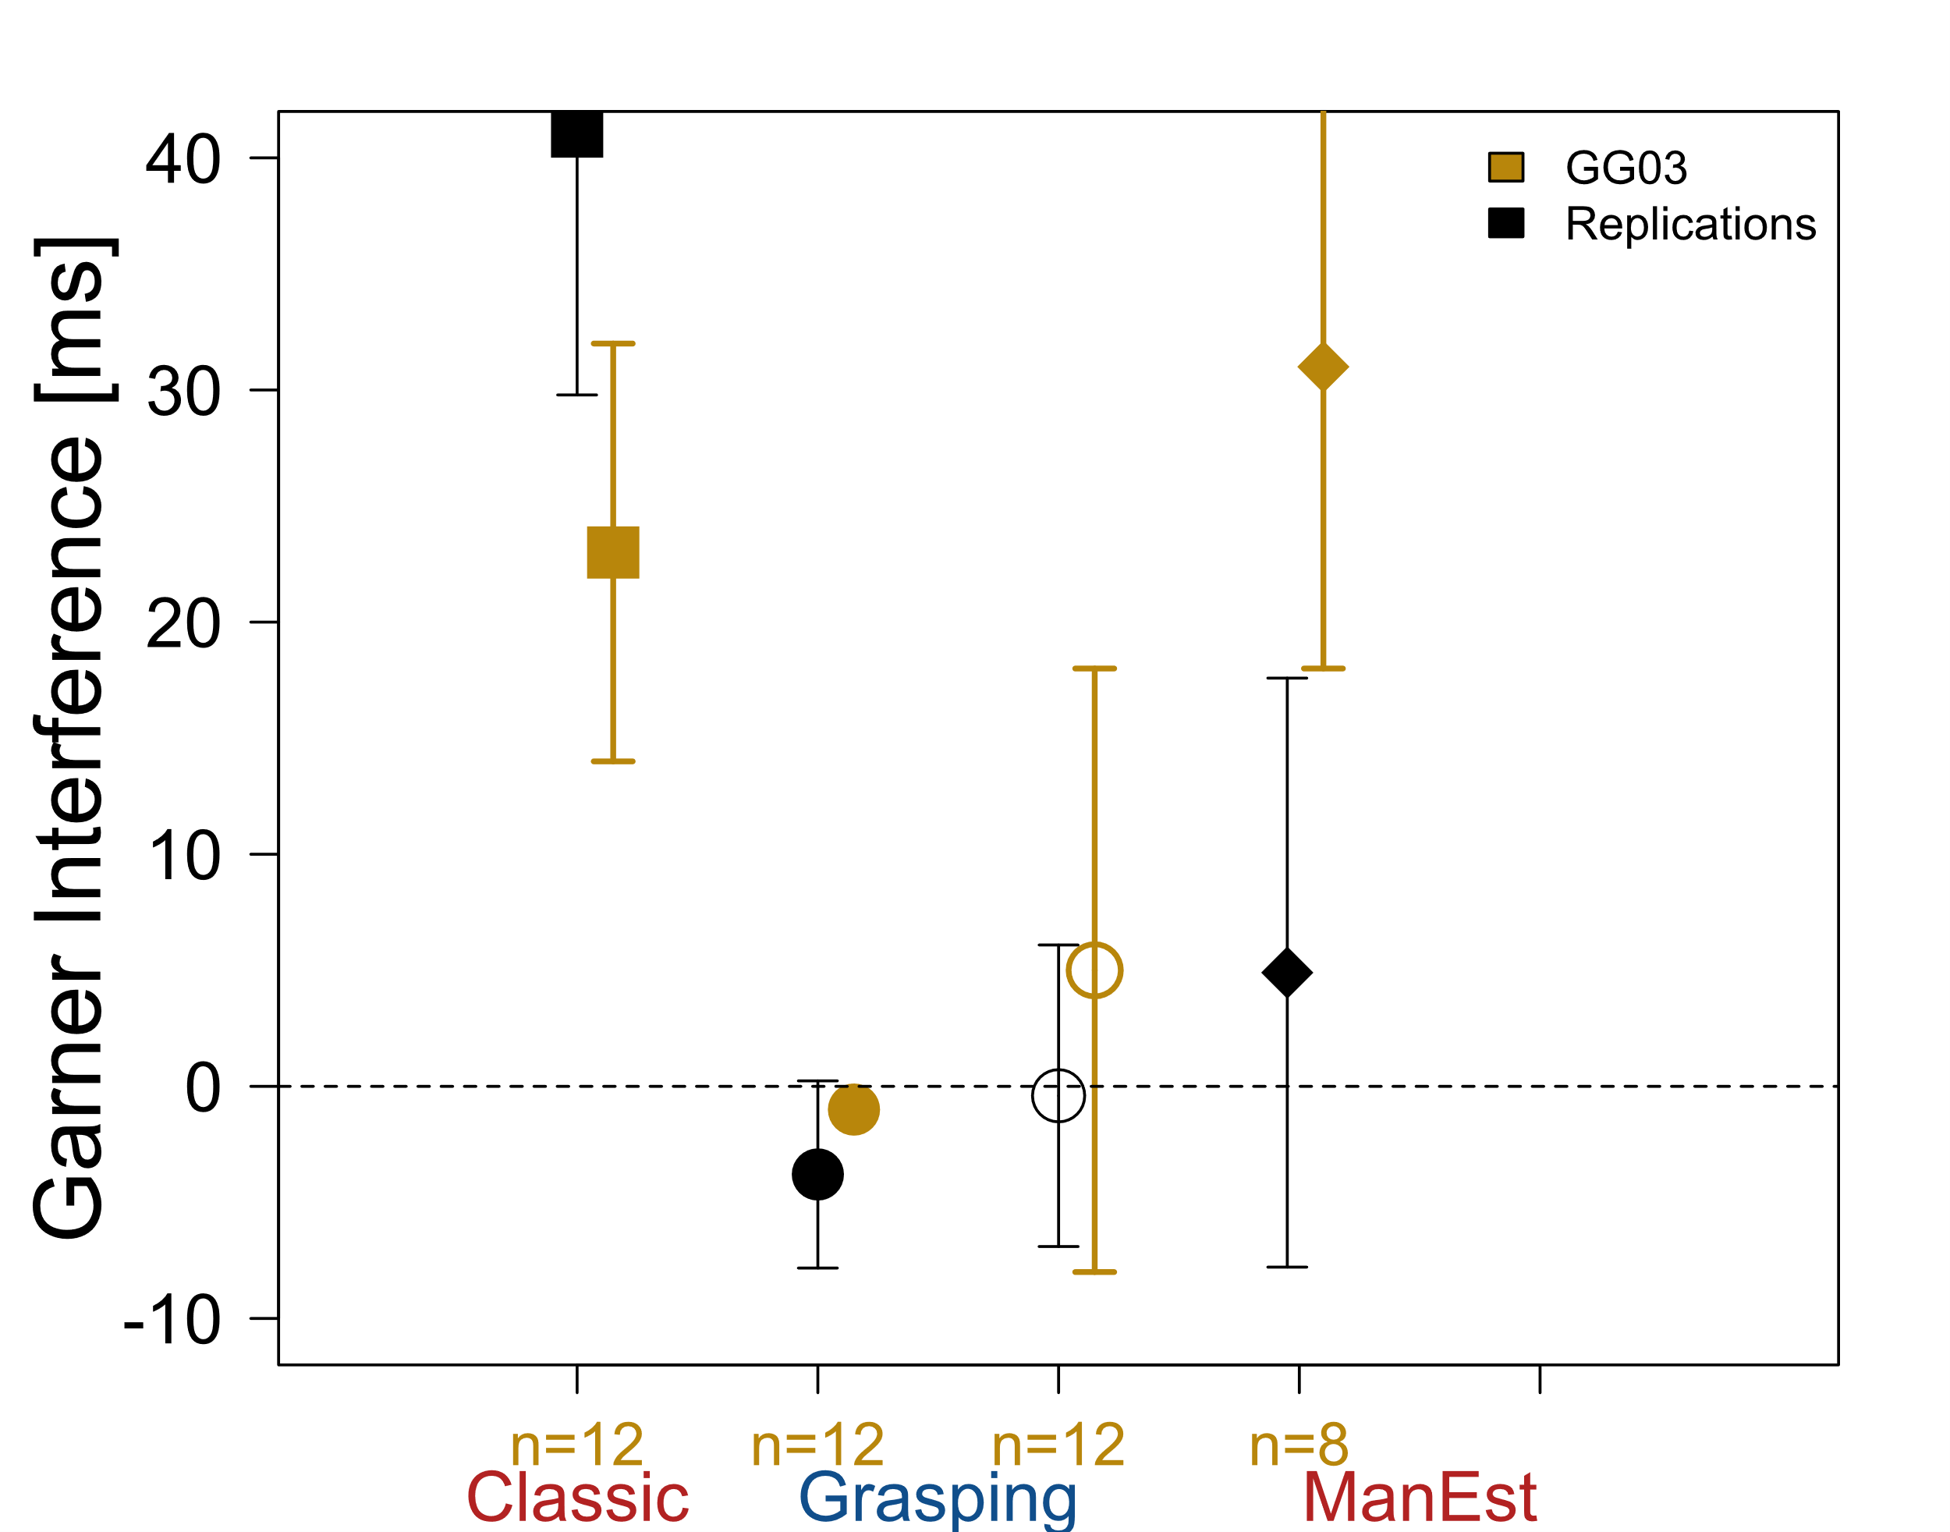
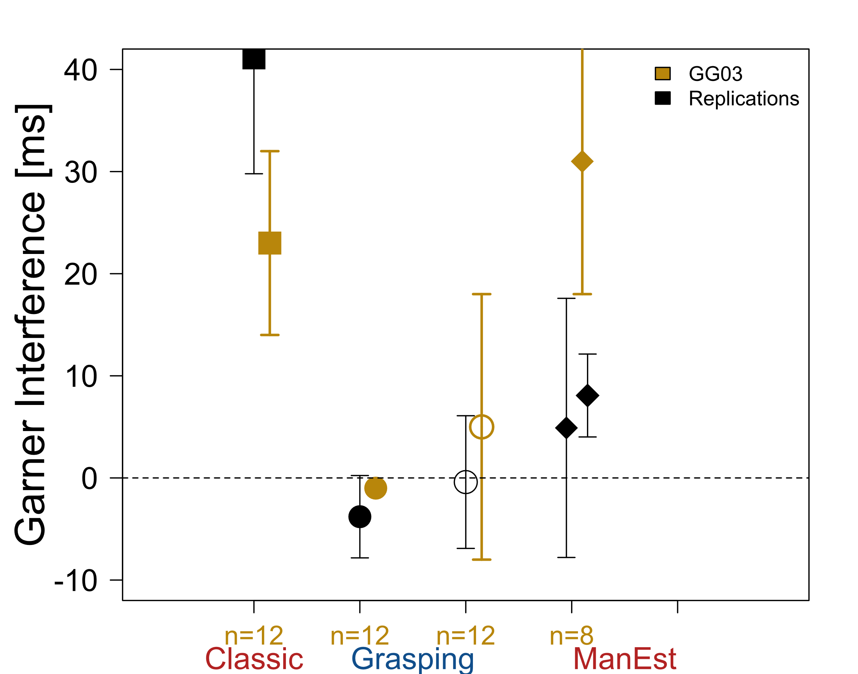
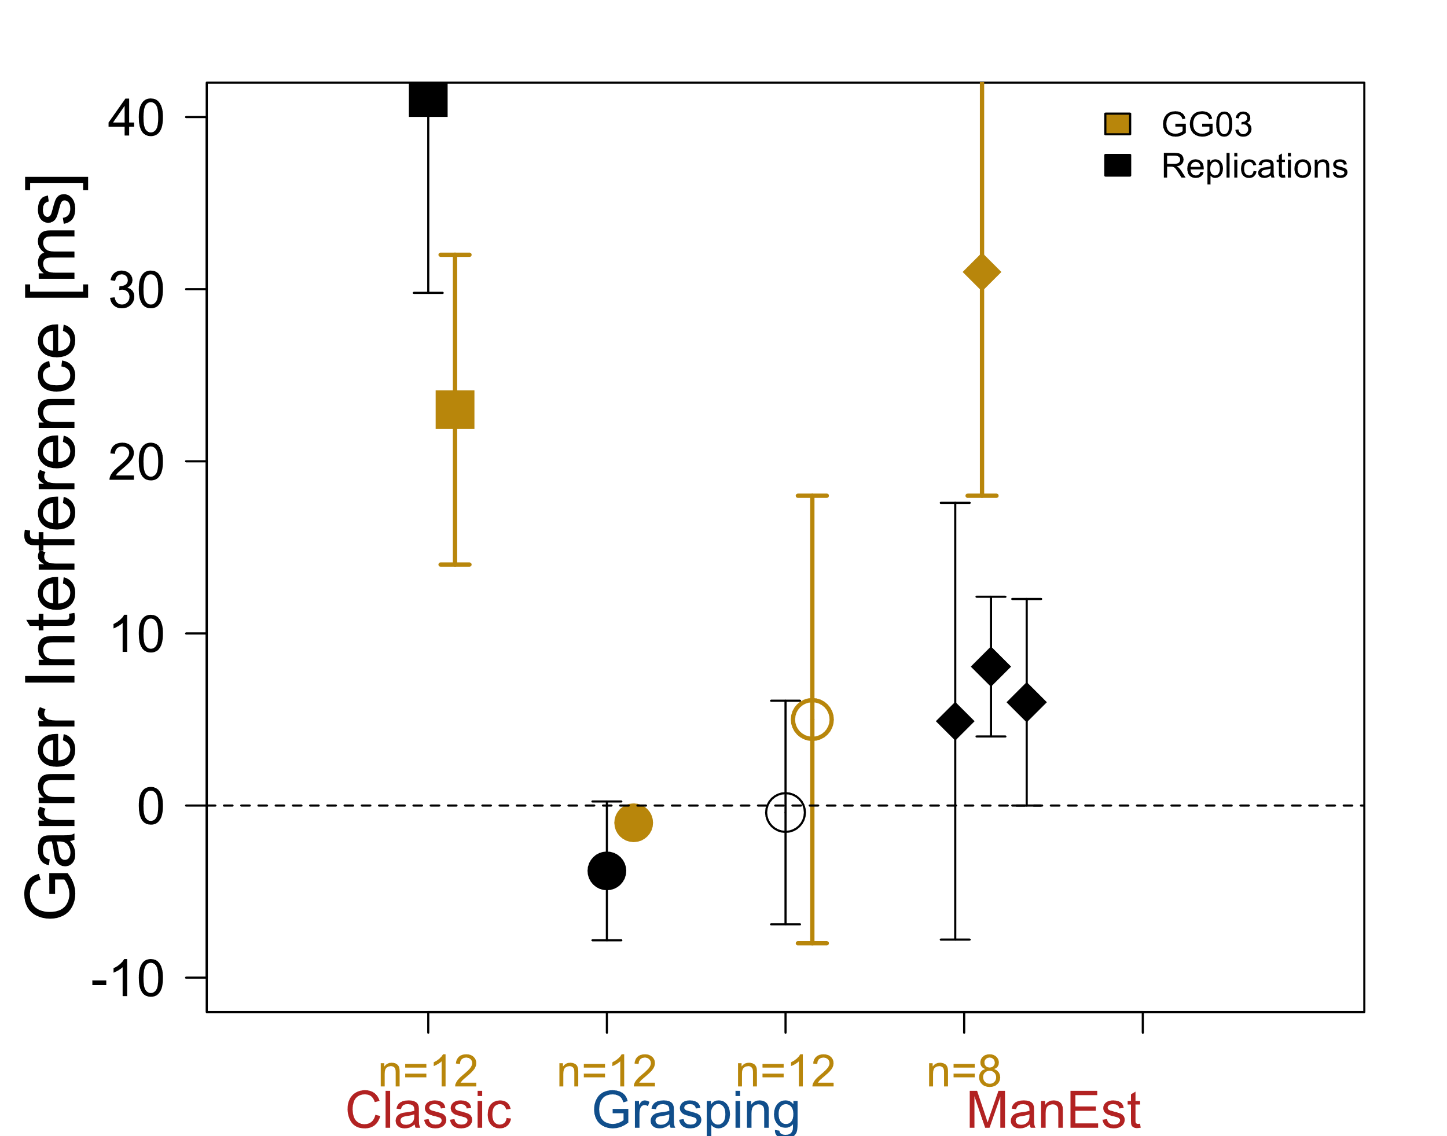
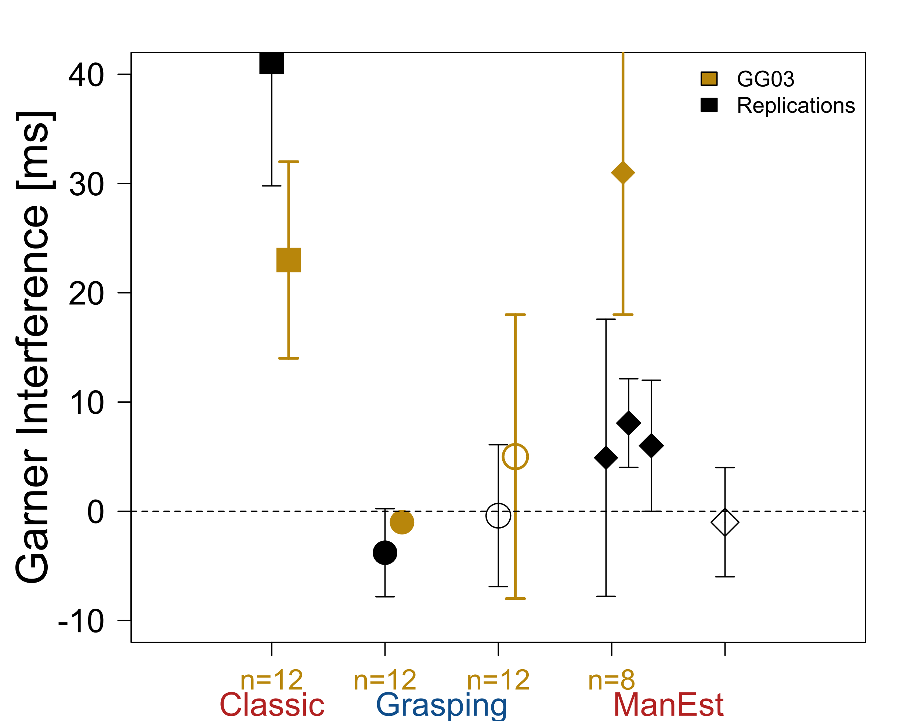
Replication Results
Exp | n | Trials
GG03 | ≤12 | 64
1 | 24 | 64
2 | 24 | 128
3 | 32 | 96
4 | 30 | 128

Slide 12
Meta-analysis of Garner Effects
Acquired and compiled data from 10 studies on Garner interference
Here only RT: only variable measured in ALL tasks
  But other DVs show similar pattern
Computed weighted mean (WM) across all studies

Slide 13
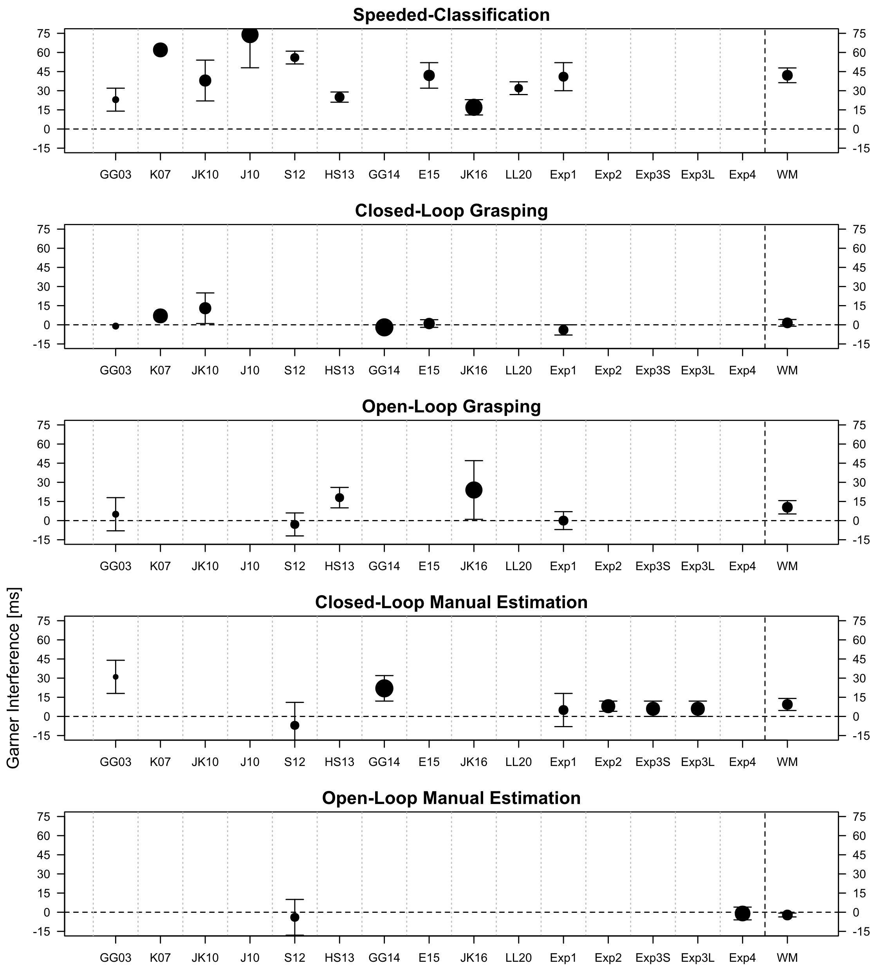
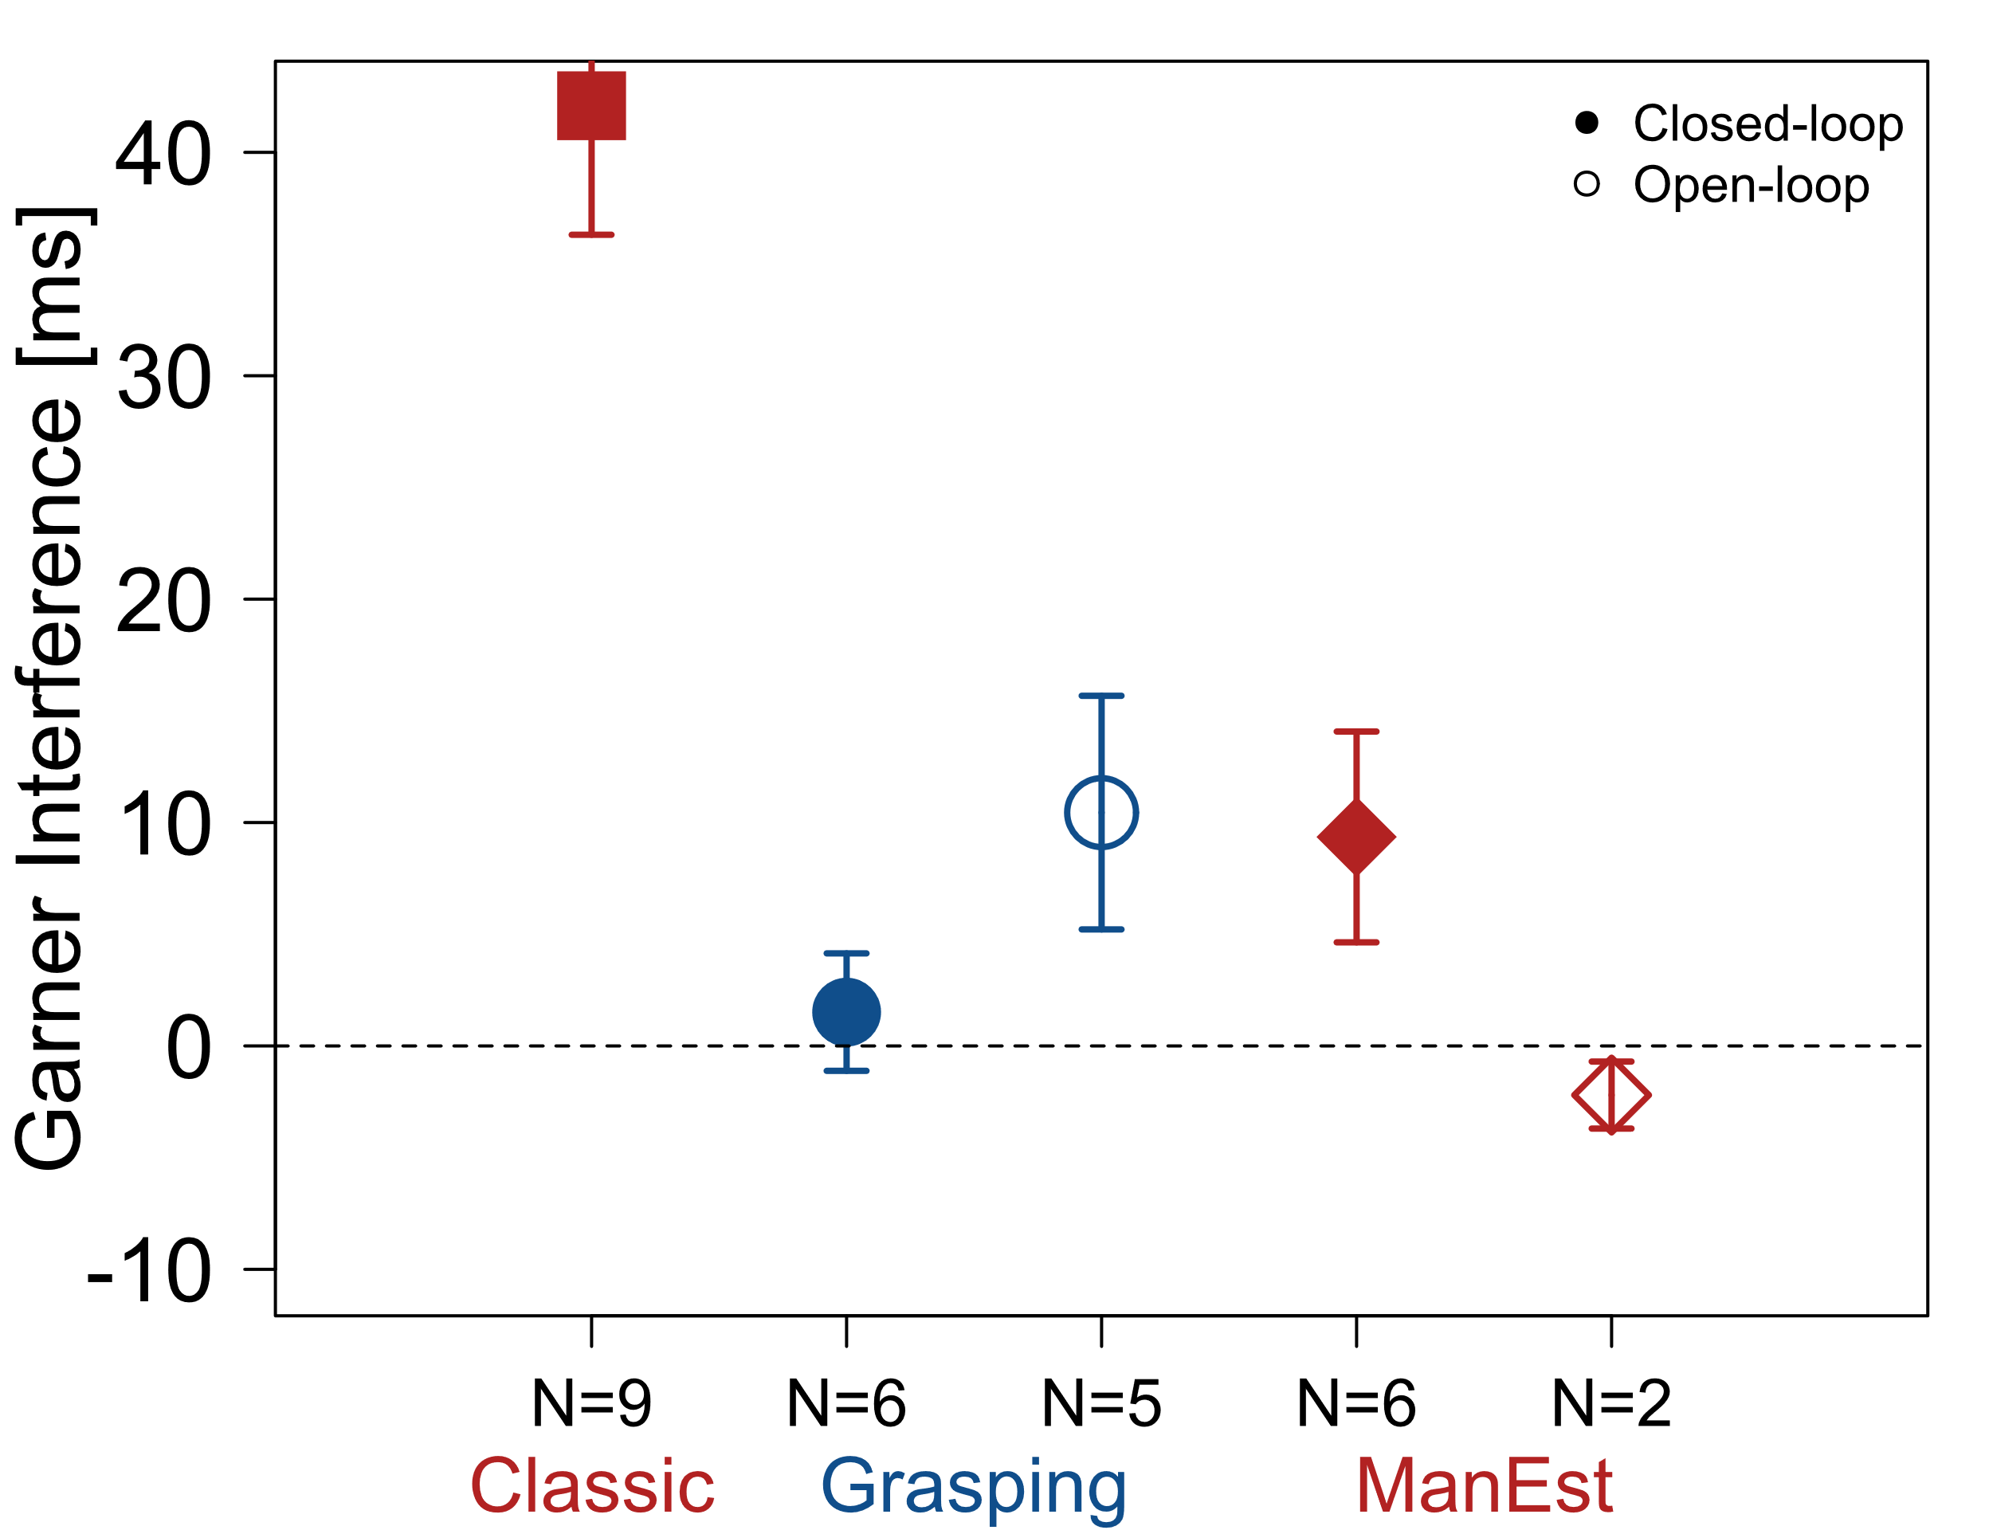
Meta-analysis: Reaction Time

Slide 14


Weighted Means: Reaction Time
N = number of studies in weighted mean

Slide 15
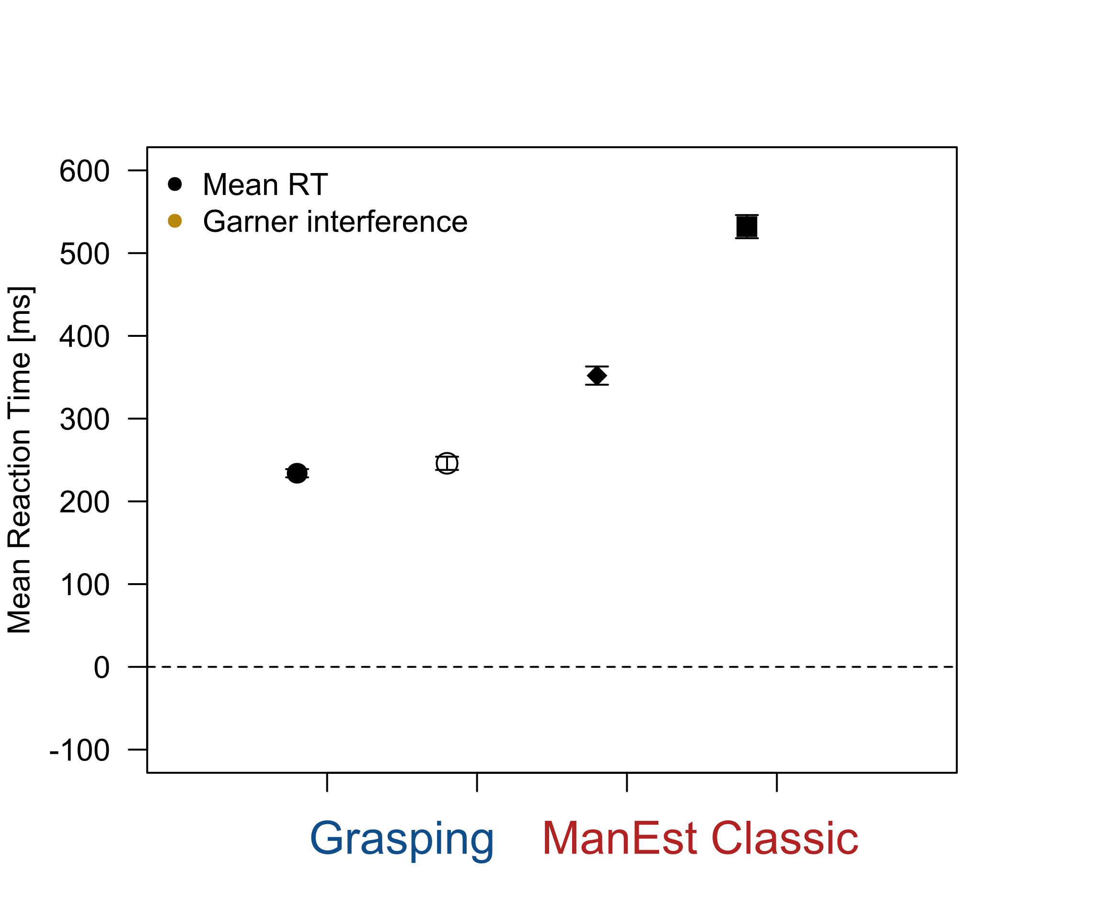
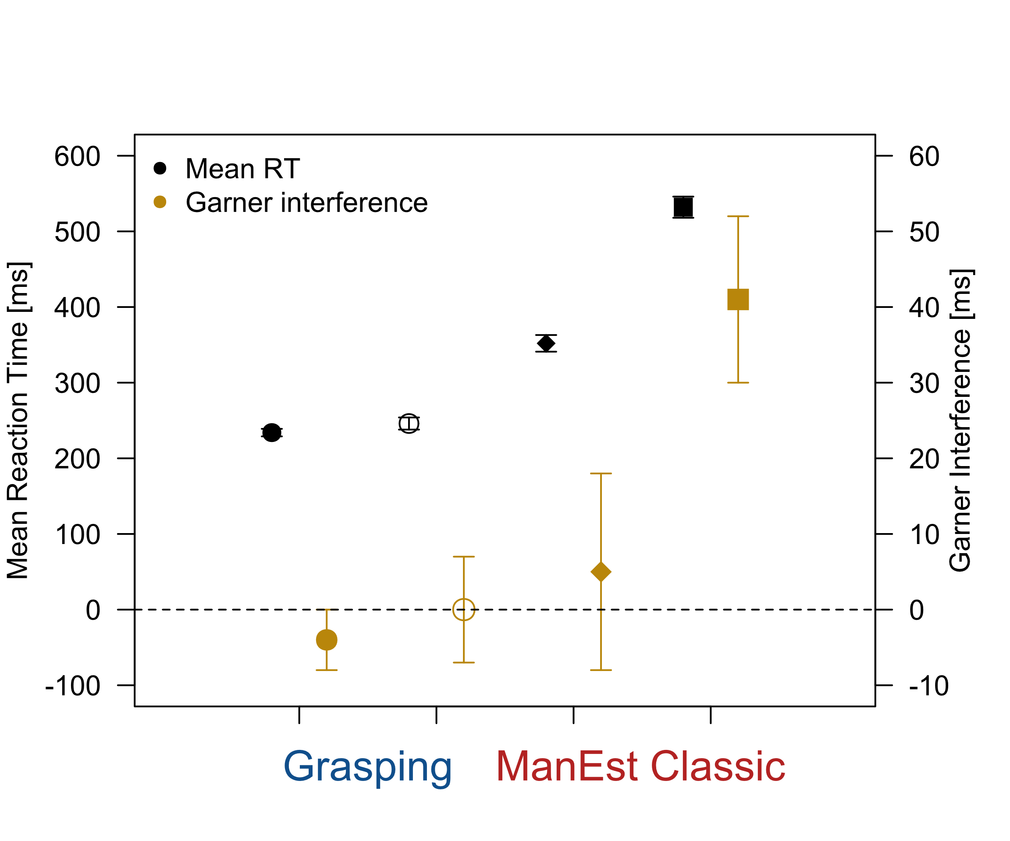
Does Garner Interference Depend on RT?
Tasks have very different RTs
Task demands not similar enough?
Longer RT = larger effect?
Experiment 1
Verhaeghen and De Meersman (1998, Psychology & Aging)

Slide 16
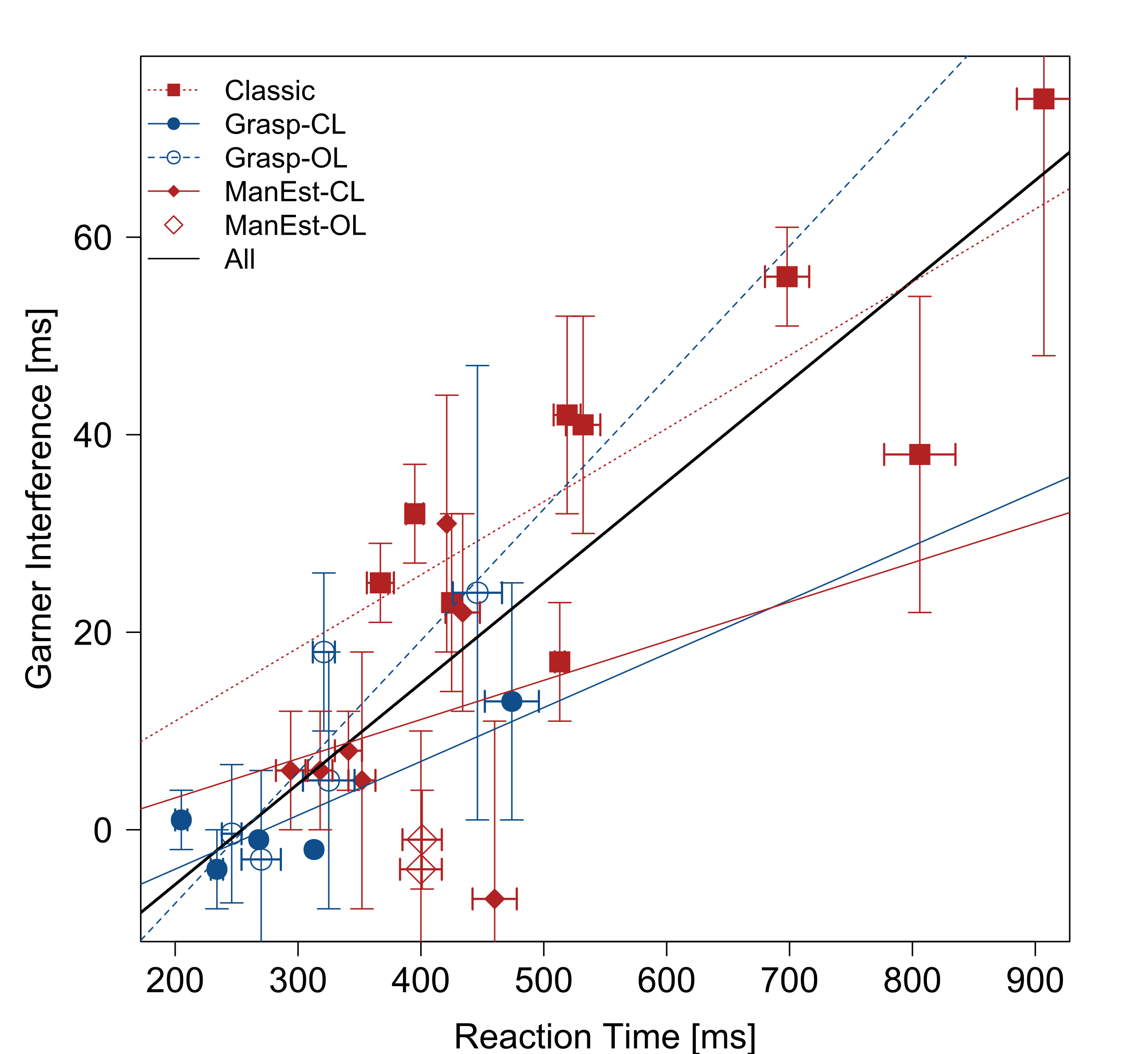
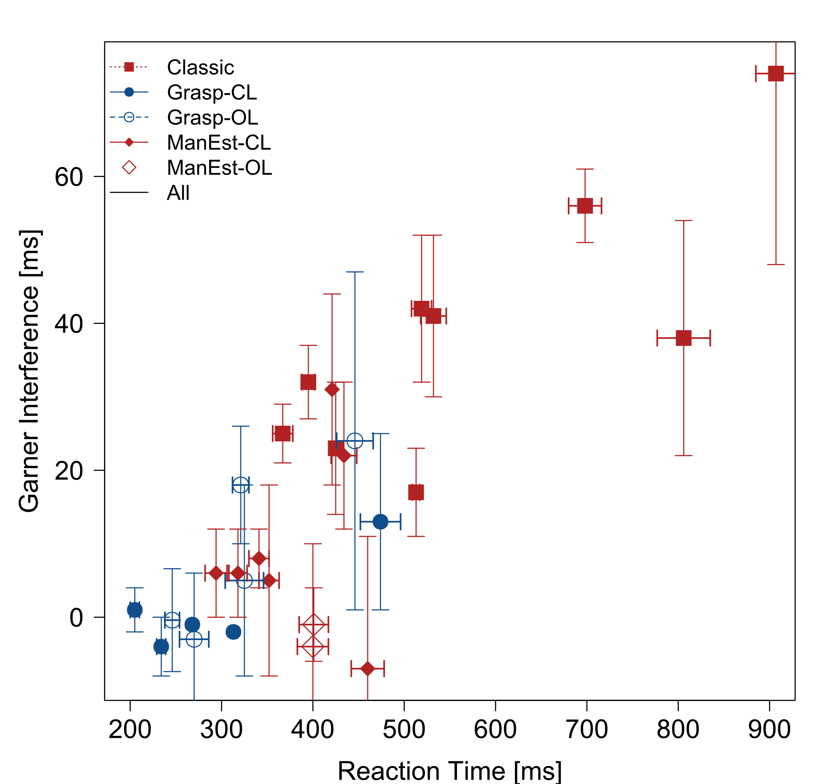
Does Garner Interference Depend on RT?
Different RTs = different Garner effects?
Not necessarily evidence for a dorsal / ventral distinction!
r = 0.83

Slide 17
Summary and Conclusions
Garner effect reported in manual estimation, not in grasping
From only two studies — Insufficient empirical support!
Only small Garner effect in manual estimation in 4 replications
No evidence for perception-action dissociation in 14 studies
Future research should focus on manual estimation

Slide 18

Thank you!
Thank you!

