Slide 1
Reviewing evidence for different representations in perception and action
Kriti Bhatia¹, Markus Janczyk², Volker H. Franz¹
¹ Experimental Cognitive Science, Department of Computer Science, University of Tübingen
² Research Methods and Cognitive Psychology, Department of Psychology, University of Bremen
Funded by Deutsche Forschungsgemeinschaft (DFG, German Research Foundation)
Project number 422180965; 381713393
Research Unit 2718: Modal and Amodal Cognition
Notes:
Hello everyone, welcome to my presentation. I want to discuss the evidence so far for different representations in perception and action.

Slide 2
Perception-Action Model
(Two visual streams hypothesis)
Visual information processing
V1 → Ventral (“what?”) & dorsal (“how?”) streams
Based on evidence from neuropsychological patients
Different purposes → different processing
Visuomotor Actions
Dorsal
V1
Ventral
Visual Perception
Goodale & Milner 1992 Milner & Goodale 1995
Notes:
The Perception-Action Model is a popular theory for visual information processing. In this framework visual information from V1 travels in independent pathways, the dorsal and ventral stream. Evidence from neuropsychological patients suggested that information in these two streams was processed for different purposes – visual perception in the ventral stream and visuomotor actions in the dorsal stream.

Slide 3
Perception-Action Model debate in healthy adults
Visual Illusions
Garner Interference
Weber’s Law
Actions resistant to illusions
No GI in action
Actions violate Weber’s Law
Perception susceptible to illusions
GI in perception
Perception follows Weber’s Law
Aglioti et al 1995
Haffenden & Goodale 1998
Ganel & Goodale 2003
Janczyk & Kunde 2012
Ganel & Goodale 2014
Ganel, Chajut, Algom 2008
Heath et al 2011
Pro
Hesse & Schenk 2013
Eloka et al 2014
Löhr-Limpens et al 2019
Utz et al 2015
Bhatia, Löwenkamp, Franz
(submitted)
Franz & Gegenfurtner 2008
Kopiske et al 2016
Contra
Notes:
3 main lines of evidence are cited in support of the Perception-Action Model in healthy adults: visual illusions, Garner interference and Weber’s law. As shown here, there is a lot of disagreement in the literature about these claims. Today I’ll be focussing on Garner interference.

Slide 4
Intuition for differences in perception vs. action
Ganel & Goodale 2003
Perception: holistic, (task-)irrelevant information cannot be ignored
Action: (task-)irrelevant information ignored
Different processing in the two streams / tasks
Ganel & Goodale 2003
Notes:
As background, I describe the study of Ganel & goodale 2003. They reasoned that perception is based on relative metrics in a way that task-irrelevant information cannot be ignored, but this is not the case for actions because they are based on absolute metrics. Therefore there must be differential processing in the two streams

Slide 5
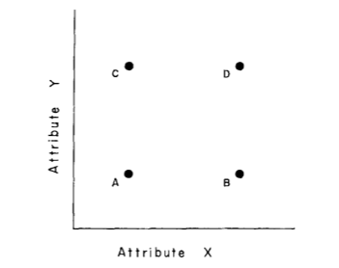
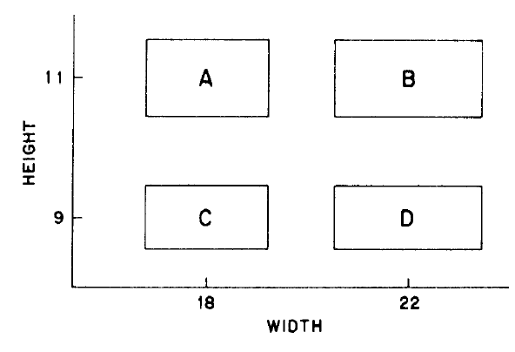
Garner’s Speeded Classification Task
Multi-dimensional stimuli, example: rectangles
Garner Interference
RT_{base} < RT_{filt}
Baseline
Filtering
Block 1
Block 2
WIDE
or NARROW?
A
B
A
B
WIDTH
Relevant
Relevant
C
D
C
D
Irrelevant
Irrelevant
LENGTH
Garner & Felfoldy 1970; Garner 1970, Felfoldy 1974, Garner 1978
Notes:
To investigate this, they applied an experimental paradigm called the Garner Task. Multidimensional stimuli, like here rectangles with the dimensions length and width, are presented one at a time. The width is the task-relevant dimension, so participants judge them as “wide” or “narrow”. They are presented in two separate conditions, the baseline where only the width differs, and the filtering where length and width both differ. Reaction times are measured, and the typical result is that RTs in the baseline are shorter than filtering, and this is Garner interference, because the task irrelevant dimension, the length, interferes with the judgement about the width.

Slide 6
Tasks and Design
⬄
Similar task demands
Grasping
(dorsal)
Manual Estimation
(ventral)
Perception
(ventral)
Ganel & Goodale 2003
Notes:
Ganel and Goodale used this kind of Garner design and had participants: grasp the presented rectangle along its width, in a perception task, they pressed a button to say whether it is wide or narrow. Next, they asked participants to estimate the width with their finger span. According to the perception action model manual estimation is ventrally processed but its more comparable to grasping.

Slide 7
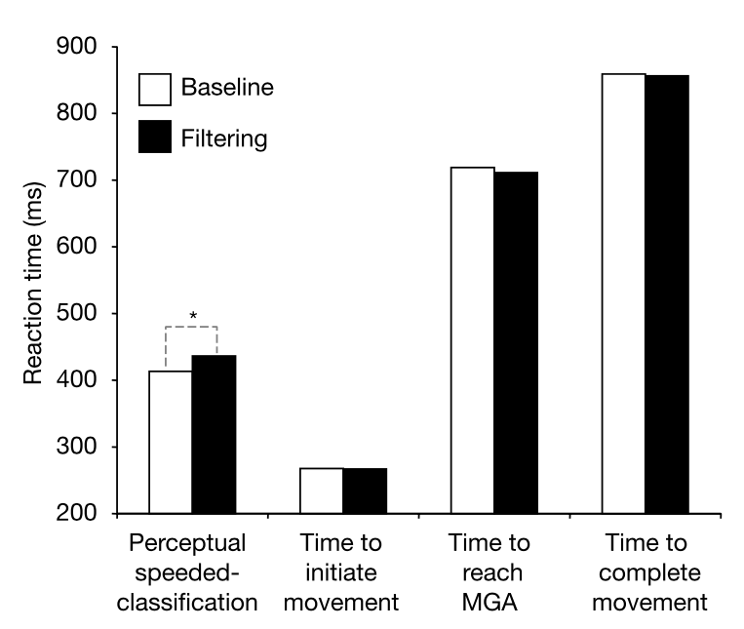
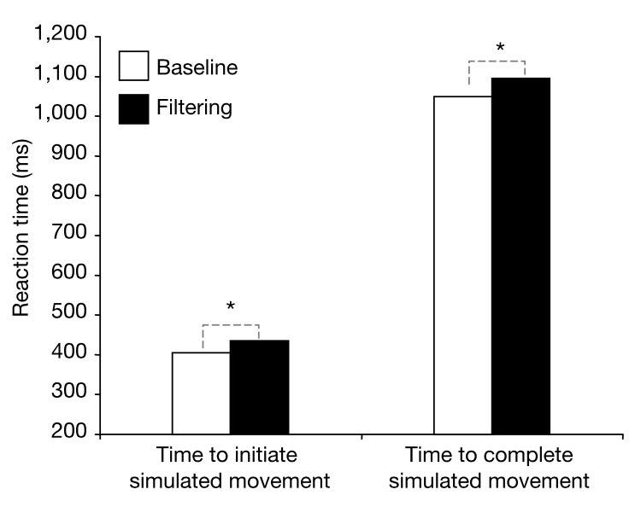
Garner Interference in Perception but not Action
Garner Interference found in perception but not action
The processing of perception and action are fundamentally different
Ganel & Goodale 2003
Notes:
As expected, they found shorter RTs in baseline than filtering in the perception task but not grasping. They also found this reaction time difference or Garner interference in manual estimation.

Slide 8
Results Overview
* p<0.05 | , p<0.1 | ns p>0.1 | Reaction Time | Start Time | ManEst Time | St. Dev. ManEst | Reaction Time | MGA Time | St. Dev. MGA
 |  |  | ms | ms | ms | mm | ms | ms | mm
(Filtering - Baseline) Mean ± SEM |  |  | Perc | Manual Estimation |  |  | Grasping
Ganel & Goodale 2003 |  | P,GN = 12 M N = 8 | 23$±$9 | 31$±$13 | 48$±$20 | 0.64 $±$0.20 | -1 | -8 | 0.001
Ganel & Goodale 2014 |  | N = 40 |  | 22$±$10 |  | 0.51 $±$0.38 | -2 |  | 0.044
Bhatia, Janczyk, Franz (in prep) |  | N = 24 | 43$±$12 | 7$±$11 | 45$±$22 | -0.25 $±$0.16 | -3.5$±$4 | -2.4$±$6.5 | -0.16 $±$0.35
Garner
Interference
First study
Follow-up study
Replication
Notes:
We replicated these experiments and here are our results. It’s clear that we replicated the results from perception and grasping but not manual estimation.

Slide 9
What else could explain absence of Garner Interference?
Found in perceptual classification and manual estimation, not in grasping
Reaction Times (RT) calculated in different ways in these tasks
RT includes decision time in perceptual classification but not grasping
Hesse & Schenk 2013
Notes:
A study in 2013 examined Garner paradigm in grasping and perception more closely, and found that the reaction times are measured differently in the two tasks. Specifically, in perception, RT includes time to arrive at a decision, but not in grasping.

Slide 10
Garner Interference depends on Decision Time
Classic
Long decision amplitude
Short decision amplitude
Narrow
Wide
Start
Narrow
Wide
Narrow
Wide
Decision occurs in-flight
5 cm
35 cm
Decision occurs before start
Button press = Decision
Start
Hesse & Schenk 2013
Notes:
Hesse & Schenk concluded this on the basis of perception tasks with varying decision amplitude. In the classic task, participants kept their fingers on the decision buttons, and Garner interference was observed. In the long amplitude condition, they began with fingers at a start button, and then moved to decision buttons far away, here no Garner interference occurred. In the short condition, the decision buttons were closer to the start button and here the Garner interference reappeared. They only tested this with a perception task, and we wanted to test their idea in manual estimation.

Slide 11
Replication Results
* p<0.05 | , p<0.1 | ns p>0.1 | Reaction Time | Start Time | ManEst Time | St. Dev. ManEst | Reaction Time | MGA Time | St. Dev. MGA
 |  |  | ms | ms | ms | mm | ms | ms | mm
(Filtering - Baseline) Mean ± SEM |  |  | Perc | Manual Estimation |  |  | Grasping
Ganel & Goodale 2003 |  | P,GN = 12 M N = 8 | 23$±$9 | 31$±$13 | 48$±$20 | 0.64 $±$0.20 | -1 | -8 | 0.001
Ganel & Goodale 2014 |  | N = 40 |  | 22$±$10 |  | 0.51 $±$0.38 | -2 |  | 0.044
Bhatia, Janczyk, Franz (in prep) |  | N = 24 | 43$±$12 | 7$±$11 | 45$±$22 | -0.25 $±$0.16 | -3.5$±$4 | -2.4$±$6.5 | -0.16 $±$0.35
Notes:
We replicated these experiments and here are our results. It’s clear that we replicated the results from perception and grasping but not manual estimation.

Slide 12
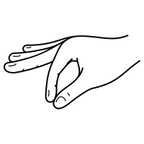
Transferring to Manual Estimation…
30 cm
Object
Object
7 cm
Start
Start
Short amplitude
Long amplitude
Notes:
We manipulated the decision amplitude by differing the distance from the start, to the position where manual estimation was performed. We measured reaction times, and reasoned that Garner interference would occur in the short condition because the decision is required soon after they begin the task, but later on in the long condition.

Slide 13
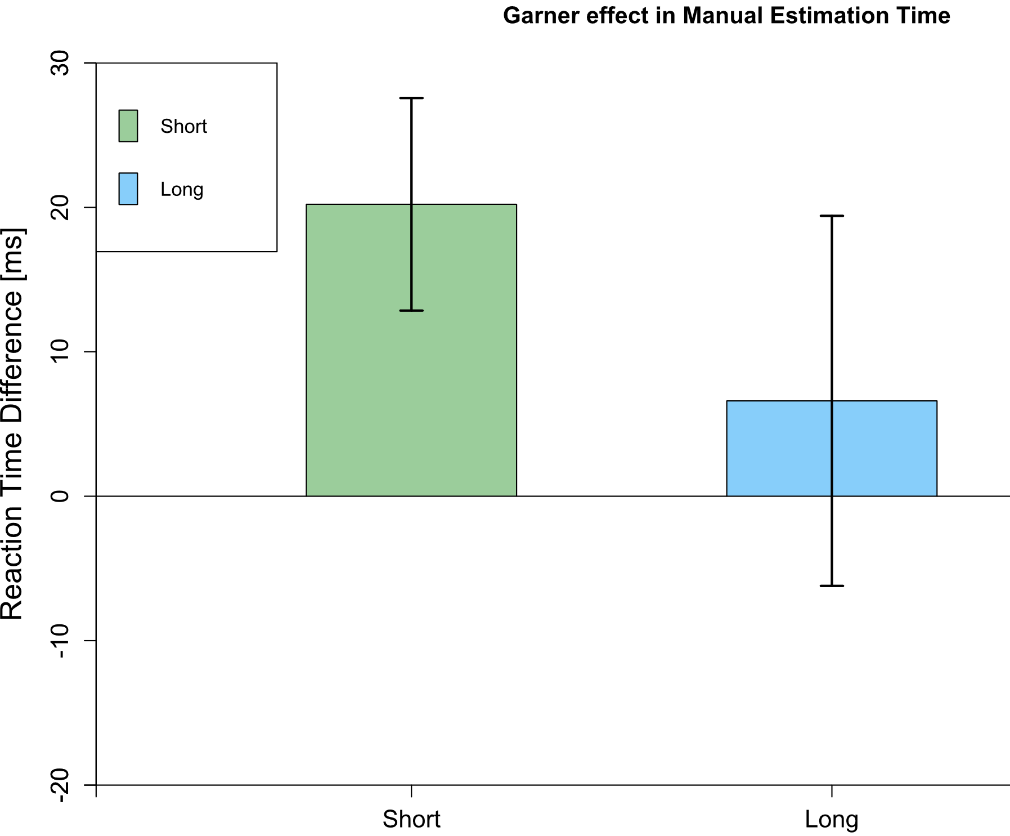
Results & Discussion
*
Garner interference eliminated by long decision amplitude
Garner interference introduced by short decision amplitude
Unreliable Garner effect in Manual estimation: more data needed!
Maybe Garner Interference does not reflect differential processing
Claims about different processing in perception vs. action may need to be re-assessed
Error bars depict Mean $±$ SEM
N = 8
Notes:
As expected, in the short condition, we found Garner interference, large reaction time difference between filtering and baseline. However, this was a pilot experiment performed with only 8 participants. In conclusion, there is an unreliable Garner effect in manual estimation, which seems to be influenced by the decision amplitude and we need more data to make definitive claims. But the evidence suggests that garner interference may not reflect processing differences, and therefore, other lines of evidence are needed to support the perception-action model.

Slide 14
Thanks for your interest!
Contact: kriti.bhatia@uni-tuebingen.de
Thanks to Angela Osenberg for data collection!

Slide 15
Garner Interference depends on Decision Time
GI in classic perceptual task
No GI in RT nor MT in long amplitude perception task
Enough time for decision, no GI in RT
Difference (GI) is spread out in MT (long)
Only small overall difference
GI in RT but not MT in short amplitude perception task
Not enough time until decision required, so GI in RT
Decision made at Start, no difference in MT
Start
Time
(RT)
Movement
Time (MT)
Manual
Estimation
Time (MET)
Hesse & Schenk 2013

Slide 16
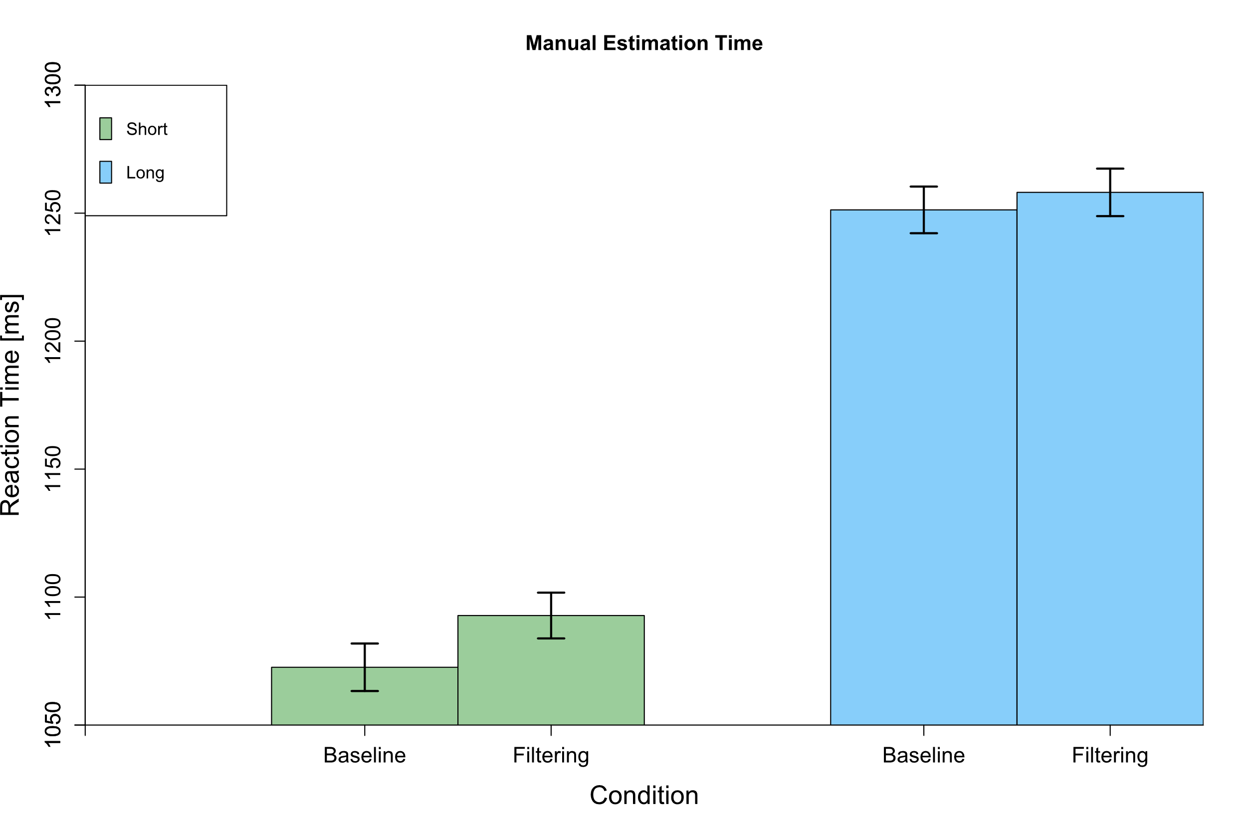

Slide 17
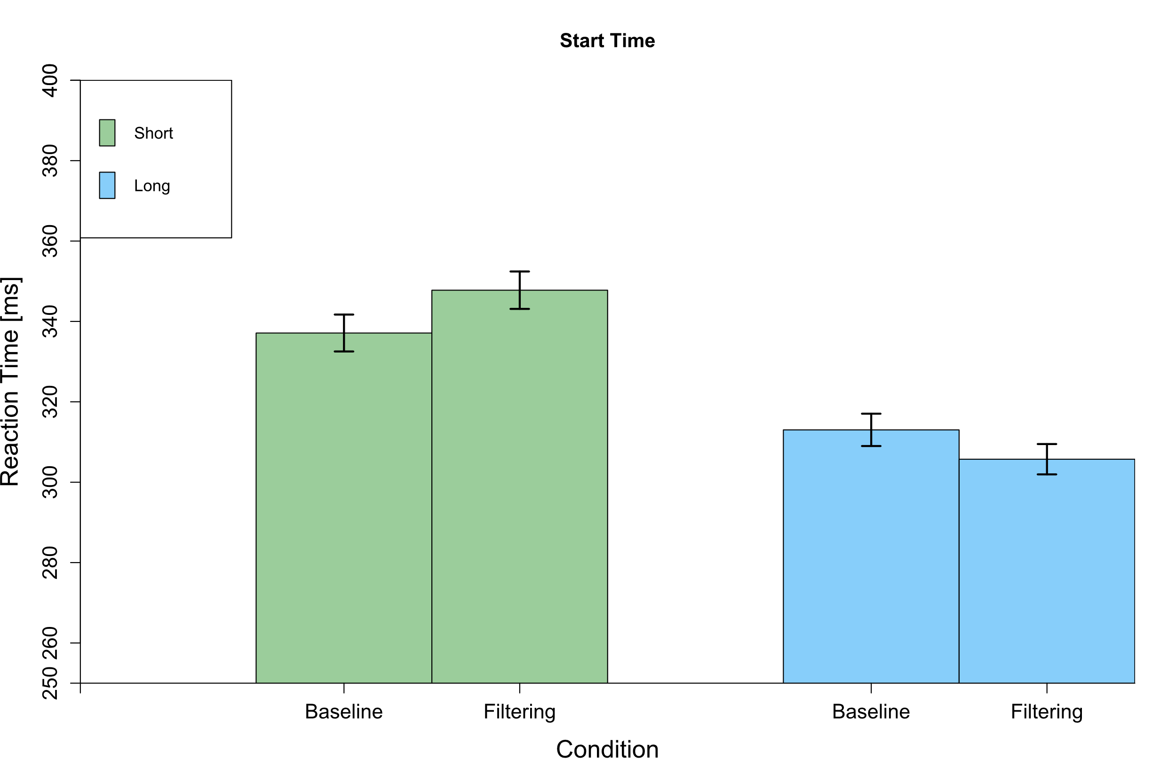

Slide 18
Replication Results – Bayes Factors
H₁ BF>3 | Weak evidence H₁ 1<BF<3 | Weak evidence H₀ 0.3<BF<1 |  | H₀ BF<0.3 | Reaction Time | Reaction Time | ManEst Time | St. Dev. ManEst | Reaction Time | St. Dev. MGA
 |  |  |  |  | ms | ms | ms | mm | ms | mm
(Filtering - Baseline) Mean ± SEM |  |  |  |  | Perc | Manual Estimation |  |  | Grasping
Ganel & Goodale 2003 |  |  | P,GN=12 M N=8 |  | 2.69 | 1.94 | 1.97 | 4.74
Ganel & Goodale 2014 |  |  | N=40 |  |  | 1.47 |  | 0.39
Replication 2021 |  |  | N=24 |  | 23.6 | 0.26 | 1.25 | 0.62 | 0.30 | 0.24
Notes:
Taking a closer using Bayes Factors, reveals that the results so far are not as clear cut as thought, because there is only weak evidence in favour of Garner interference in manual estimation.

